Slide 1
DUVALL 2015 COMPREHENSIVE PLAN UPDATE and SURVEY RESULTS
9:00 – 10:30 AM
Survey Results 30 minutes (Lara)
Comprehensive Plan, Density and Capacity, and Capital Facilities 60 minutes (Roger)

Slide 2
SURVEY RESULTS
The survey is open until 2/28
As of today we have over 400 responses
At the last CC WS we looked at a few of the preliminary results
Today we will look at some of the other questions

Slide 3
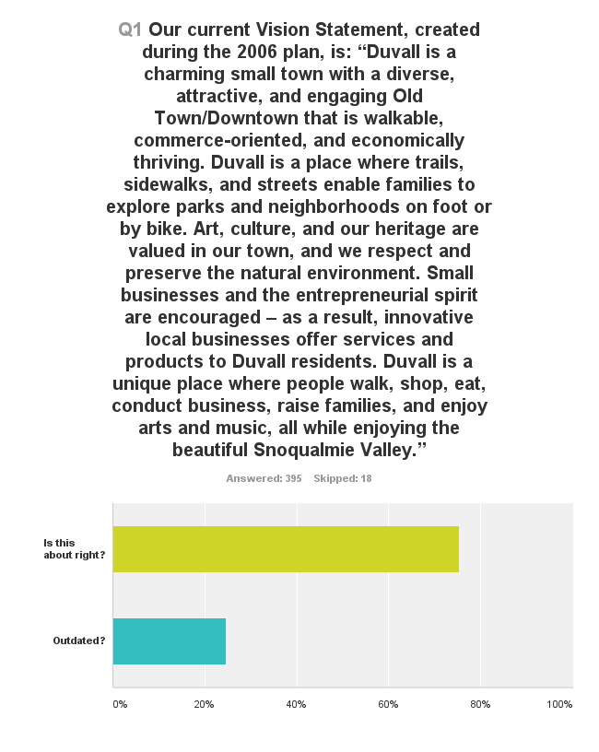
VISION STATEMENT

Slide 4
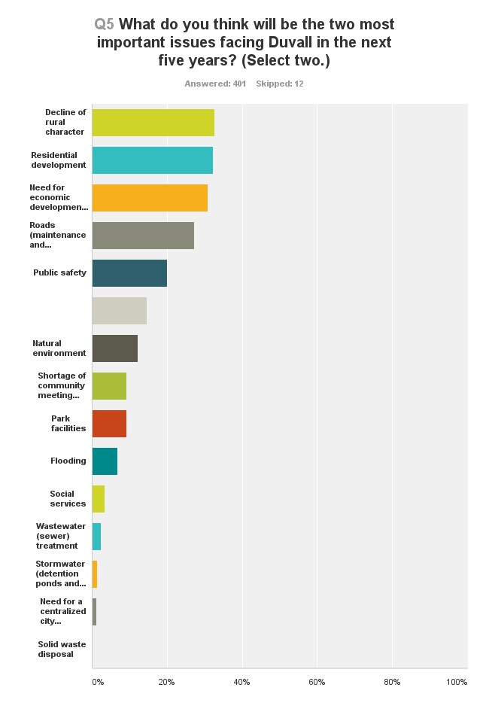

Slide 5
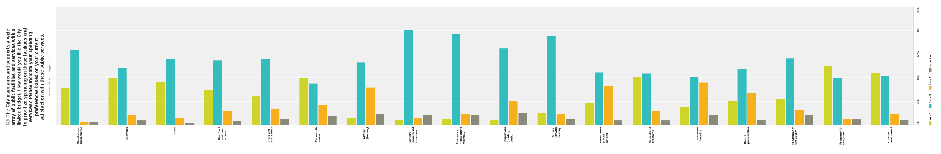
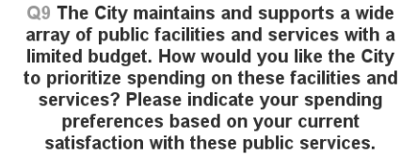

SPENDING PRIORITIES

Slide 6
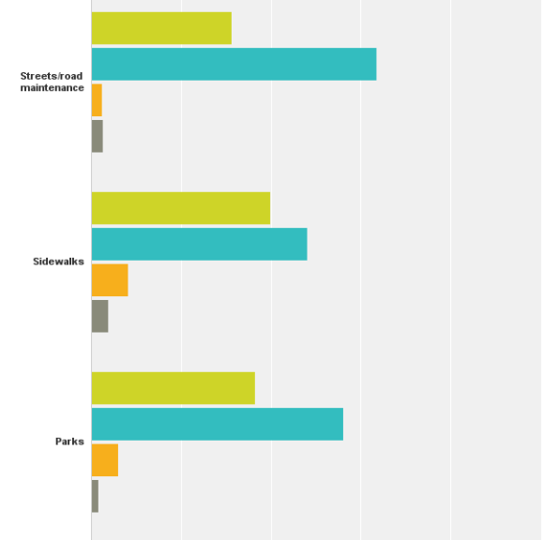
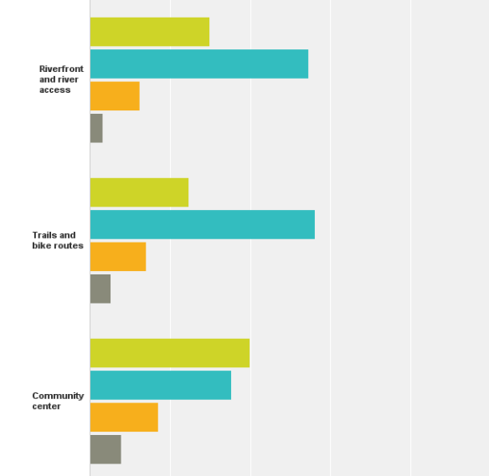
SPENDING PRIORITIES

Slide 7
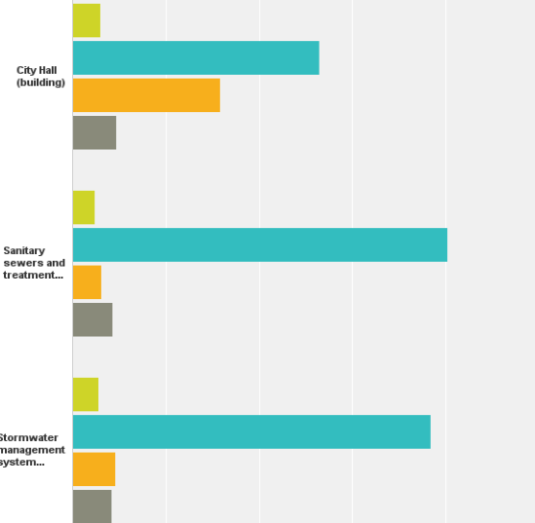
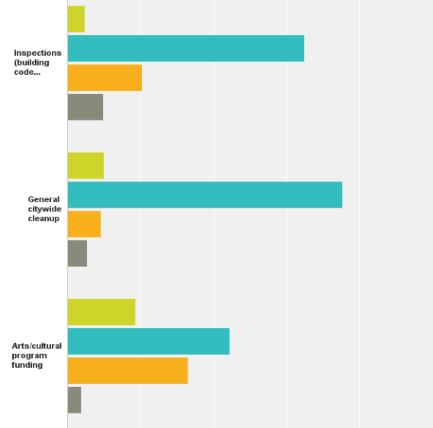
SPENDING PRIORITIES

Slide 8
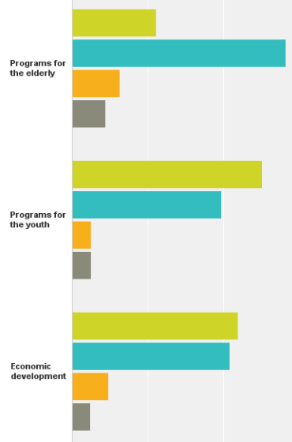
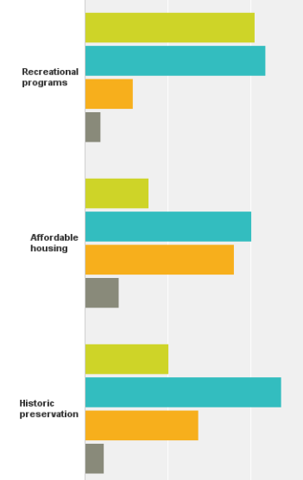
SPENDING PRIORITIES

Slide 9
SPENDING PRIORITIES
Highest spending priorities –
Programs for youth
Economic Development
Recreational programs
Community Center
Sidewalks

Slide 10
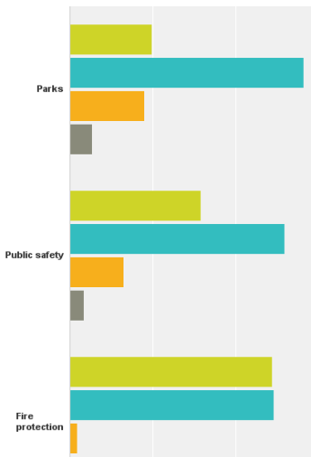


HOW ARE WE DOING?

Slide 11
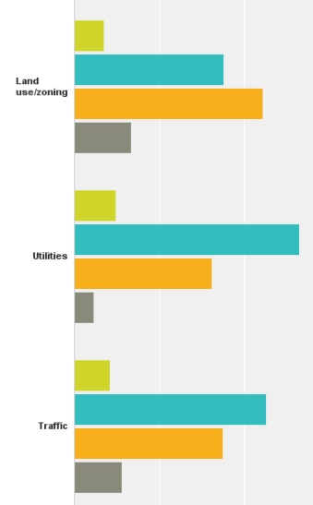
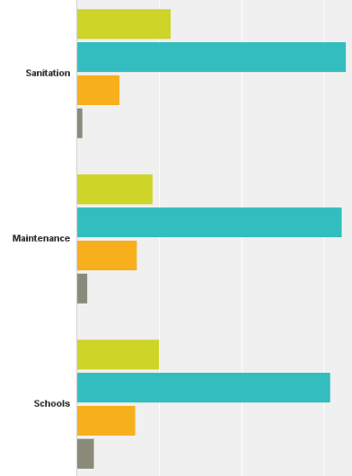
HOW ARE WE DOING?

Slide 12
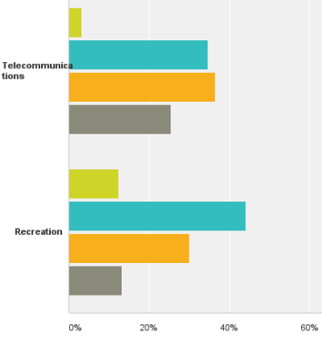
HOW ARE WE DOING?

Slide 13
RESULTS & RECOMMENDATIONS
Doing well on:
Public Safety
Fire Protection
We should work on:
Telecommunications
Traffic
Recreation
Land Use/Zoning

Slide 14
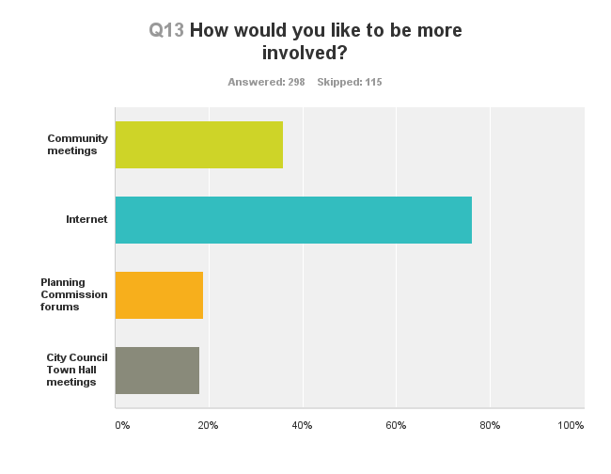
BETTER WAYS TO COMMUNICATE

Slide 15
STATUTORY CONTEXT
Growth Management Act – 25 years in force
Frequent legislative amendments, Growth Board interpretations, and court decisions
Updates drive conformance with the current GMA as amended
Includes comprehensive plans, critical area regulations, preservation of resource lands, and development regulations (zoning)

Slide 16
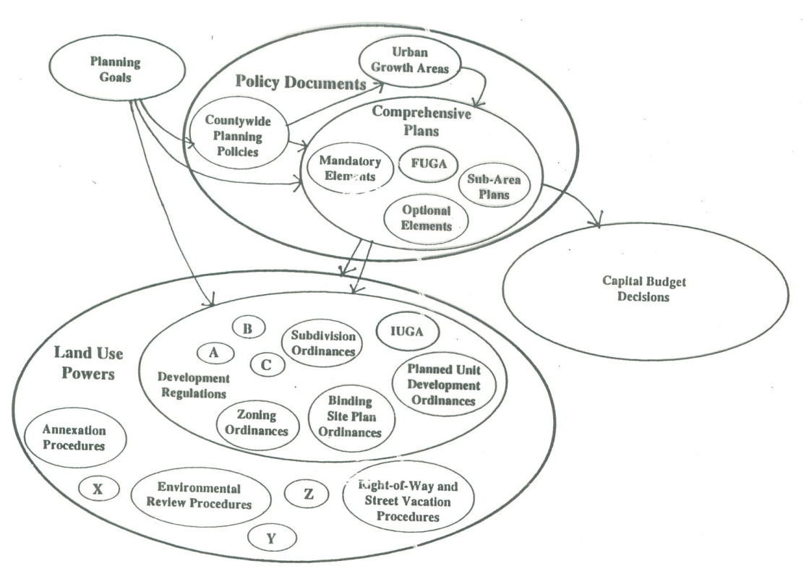
STATUTORY CONTEXT

Slide 17
REGIONAL CONTEXT
Countywide Planning Policies
Vision 2040 (Puget Sound Region Council)
Transportation 2050 (Also PSRC)
Interlocal Agreements with King County (Urban Growth Areas and Future Annexations)
State Agency Plans and Programs

Slide 18
RELATED PLANS AND PROGRAMS
Shoreline Master Program
Comprehensive Flood Hazard Management Plan
Water, Sewer, Storm Functional Plans
Transportation Plan
Park, Open Space, and Recreation Plan
Economic Development Plan
Neighborhood and Old Town Plans

Slide 19
DUVALL 2015 UPDATE
Citizen Participation
Create a Vision of Duvall for 2035
Consider the growth capacity for land use and public facilities and services
Integrate the SMP and Watershed Plan
Revisit the goals and policies for all elements
Make the Plan more “intelligent” and readable

Slide 20
SCHEDULE
2013 – Scope of Work, Participation Plan, Advisory Committee, GMA Review, Vision
2014 – Docketing, Element Reviews including background analysis, goals and policies, Initiate EIS
2015 – Update Drafting, Public Reviews, EIS Evaluation, Integration, State GMA Review, Adoption

Slide 21
Relative Population Growth
City has grown at about 3.1% per year
Urban cities grow at a faster pace then counties
GMA at work

Slide 22
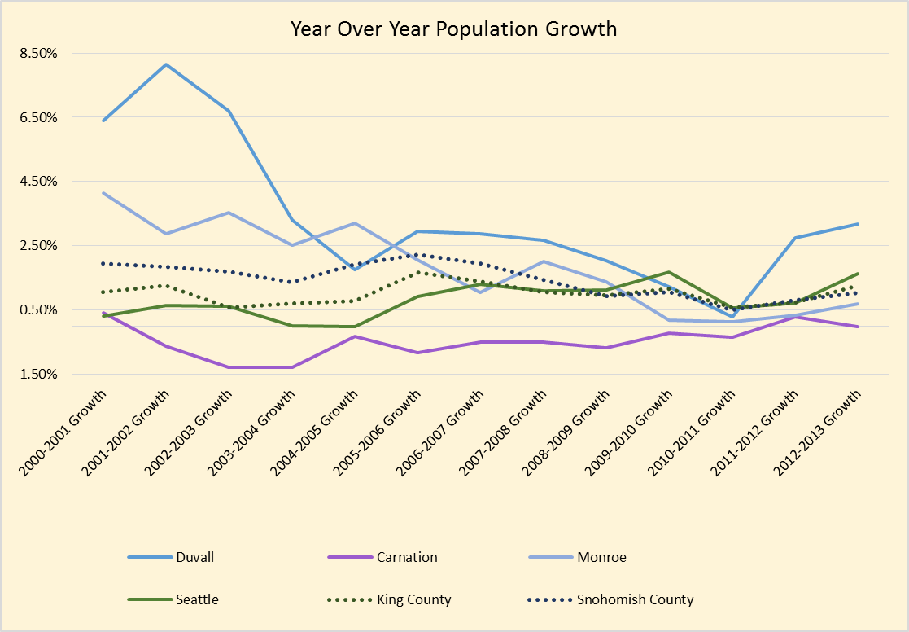
Population Growth

Slide 23
City Population and Growth
City has small population base of 7,000, with 14th smallest population of 39 cities in King County in 2013.

Slide 24
FUTURE GROWTH
Growth is projected by PSRC at 1.3% per year from 2010 to 2035

Slide 25
LAND CAPACITY
Based on current zoning
Historic development patterns
Regional market activity
Critical areas
Other constraints
February, 2013 King County Data:
2031 Housing Target = 1,140 Units
Estimated Capacity= 2,650
2031 Employment Target=840 Jobs
Estimated Capacity=1,600 Jobs

Slide 26
LAND CAPACITY
In 2006, and reaffirmed in 2009 Duvall’s Land Capacity was estimated to be approximately 12,000 at full build out.
This number is derived by zoning and a spatial analysis (with assumptions)
Assumptions
Infill development
Re-development
Gross density
Assume a % that is not going to develop
Assume a % that is not usable
Minimum density

Slide 27
LAND CAPACITY
The population number was then used to determine future CF needs
Roads, storm, sewer, water, parks, etc.
Fees are then calculated based on the population and CFP
During the CP update if we decide to lower our future build out
CF will need to be re-evaluated and impact fees re-assessed

Slide 28
CONTENT
GOALS & POLICIES
DATA
ANALYSES
STRATEGIES
ACTIONS

Slide 29
ELEMENTS

Slide 30
CAPITAL FACILITIES
WATER
SEWER
STORMWATER
TRANSPORTATION
GENERAL GOVERNMENT
SCHOOLS
PARKS

Slide 31
FACILITY ANALYSIS
Inventory – Characteristics, Location, etc.
Existing Conditions and Needs
Future Demands
Improvement Plans
Costs
Financing Strategies
Priorities

Slide 32
GENERAL GOVERNMENT
City Hall
Public Works – shops, storage, and yard
Tech Center
Permit Center
Police Station
Old Library
Youth Center
Community Center
Parks

Slide 33
STRATEGIES
“Cure” current shortfalls?
Plan/Build for the long term?
Phasing?
Best locations?
Community demands and perceptions?
Financing?
Grants
Loans
Bonds
Impact Fees
Other

Slide 34
Questions

