Slide 1
DENSITY
How Closely We Live With Each Other

Slide 2
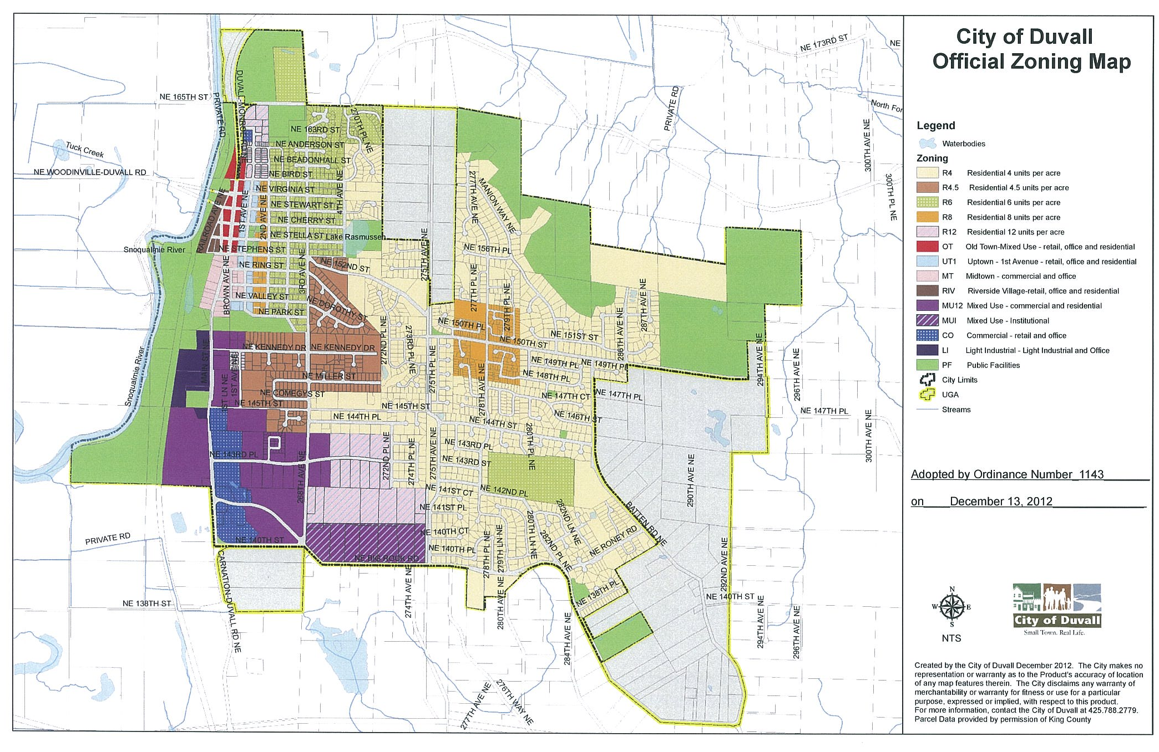

Slide 3
DUVALL DEFINITION
“Density” means the number of allowed housing units per acre of land in a designated zoning district within the City.

Slide 4
SINGLE FAMILY ZONES
 | Minimum Density (Units/Gross Useable Acre) | Maximum Density (Units/Gross Useable Arce) | Minimum Lot Area
R4 | None | 4 | 6,000 S.F.
R4.5 | None | 4.5 | 6,000 S.F.
R6 | 4 | 6 | 5,000 S.F.
R8 | 6 | 8 | 4,000 S.F.

Slide 5
GROSS vs NET
Gross = Total Site Area ÷ Number of Lots
Net = Total Site Area (minus rights of way, easements, critical areas, parks/open spaces, etc) =
Net Developable Area ÷ Number of Lots

Slide 6
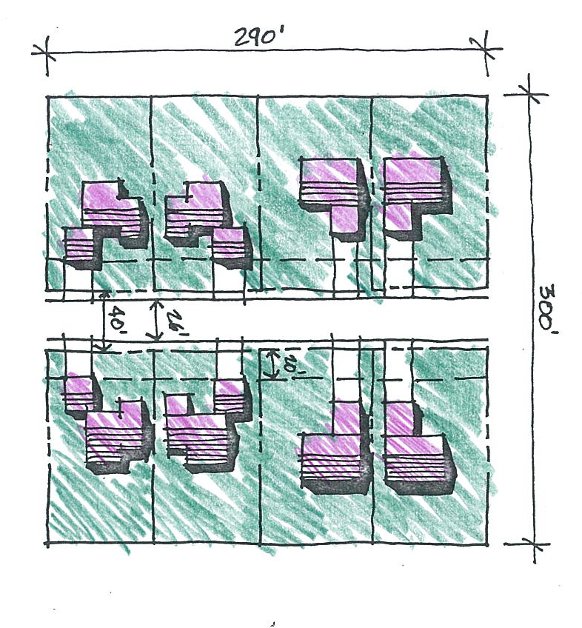
SAMPLE @ 4 UNITS/ACRE
Public Street
Net Density = Gross Density
Average Lot Size = 9,425 S.F.
Minimum Front Yard = 20’
Minimum Side Yard = 10’
Street Right of Way = 40’

Slide 7
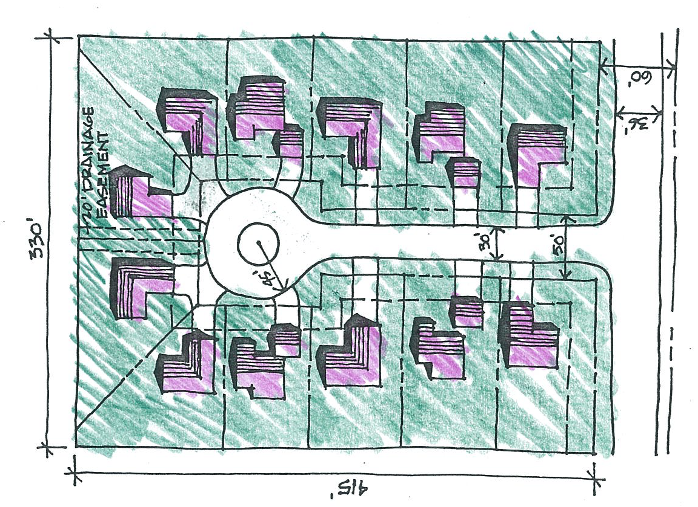
SAMPLE @ 4 UNITS/ACRE
Cul-De-Sac
Gross Density = 3.56/A
Net Density = 3.82/A
Average Lot Area = 9,675
Min. Front Yard = 20’
Min. Side Yard = 15’
R.O.W. Area = 20,800 S.F.
(~10%)

Slide 8
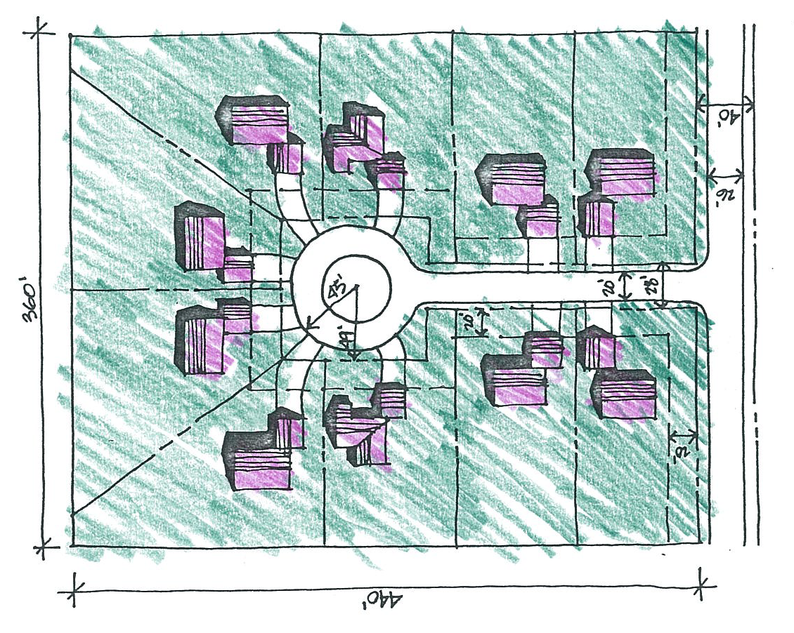
SAMPLE @ 2.75 UNITS/ACRE
Cul-De-Sac
Gross Density = 2.62/Acre
Net Density = 2.75/Acre
Average Lot Area = 14,400 S.F.
Min. Front Yard = 20’
Min. Side Yard = 10’
R.O.W. Area = 14,900 S.F.
(9.5 %)

Slide 9
CODE REQUIREMENTS
Lot Size, Lot Width Circle, Lot Frontage
Front, Side, Rear, Alley Setbacks
Lot Coverage
Impervious Surfaces Coverage
Floor Area Ratio
Building Height

Slide 10
DEVELOPMENT CAPACITY
PER 2007 BUILDABLE LANDS REPORT
Vacant Single Family Zoned Land = 58 Acres
Critical Areas = 6.2 Acres
Row (~ 15%)
Public Purpose (~ 6%)
Market Factor (~15%)
Net Acres = 29 Acres
Net Capacity = ~ 6 Units/Acre

Slide 11
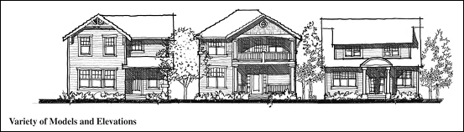
DESIGN

