Slide 1

Comprehensive Plan Citizen Survey Results
March 2014

Slide 2
Demographics

Slide 3
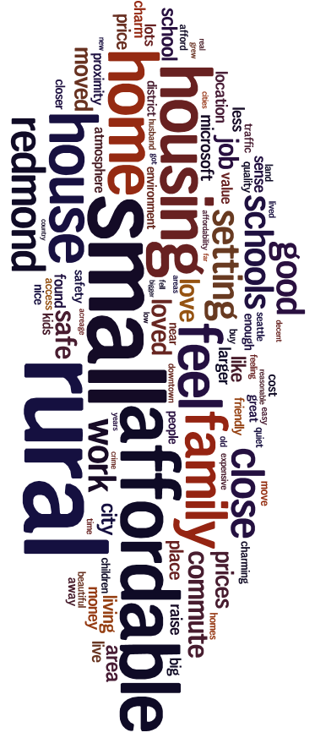
Why did you move to Duvall?

Slide 4
Vision

Slide 5

How would you like to see Vision Statement enhanced?

Slide 6
Quality of Life

Slide 7

What are the top three things about Duvall that you value?

Slide 8
Most important issues facing Duvall in next 5 years

Slide 9

What are the top three issues facing Duvall today?

Slide 10

What are the two most important issues in the next five years?

Slide 11
Grading our Local Services

Slide 12
Spending Priorities

Slide 13

What would be your top three spending priorities?

Slide 14
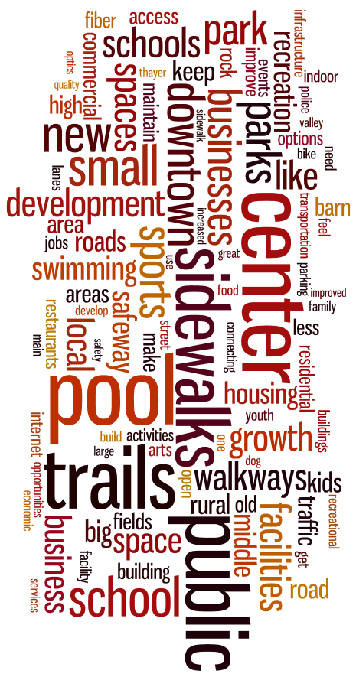
Three new things accomplished in the next 20 years

Slide 15
City Connection
How do you rate your overall connection to the Duvall community (through volunteering, attending City meetings, participating in local events and recreation, talking to an elected official, etc.)?

Slide 16
Community Involvement
On average, how many hours do you ordinarily spend in a normal month attending or taking part in any kind of organized group activity or event (not associated with your job) that involves other members of the Duvall community?

Slide 17
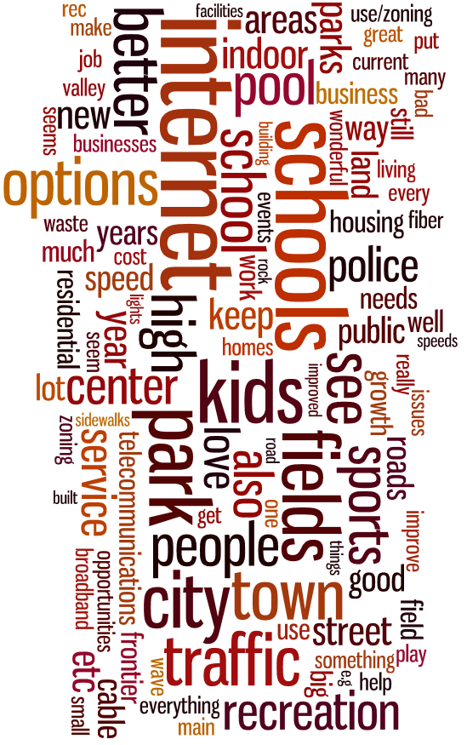
Services and facilities needed to keep pace with city demands

Slide 18
Shopping Inside Duvall

Slide 19
Where do you shop most outside of Duvall

Slide 20
Shopping Locations by Service

Slide 21
Purchase Locations - table
 | Gasoline | Groceries | Hardware | Household Items | Dining | Clothing | Prescriptions | Healthcare
Duvall | 66% | 60% | 36% | 16% | 38% | 1% | 67% | 35%
Carnation | 2% | 1% | 1% | 1% | 2% | 0% | 0% | 0%
Monroe | 6% | 6% | 24% | 10% | 7% | 6% | 1% | 2%
Redmond | 9% | 21% | 31% | 46% | 30% | 51% | 15% | 31%
Woodinville | 13% | 10% | 5% | 18% | 13% | 16% | 4% | 9%
Other | 4% | 2% | 2% | 9% | 9% | 27% | 13% | 23%

Slide 22
Commute Method

Slide 23
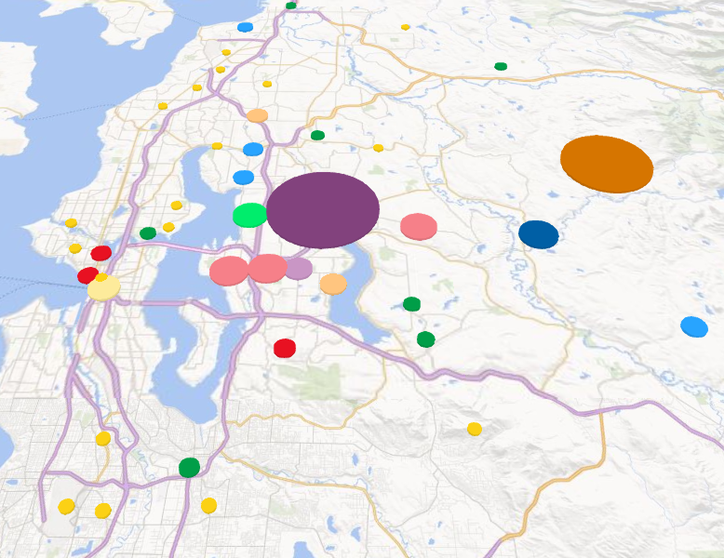
Commute Location

