Slide 1
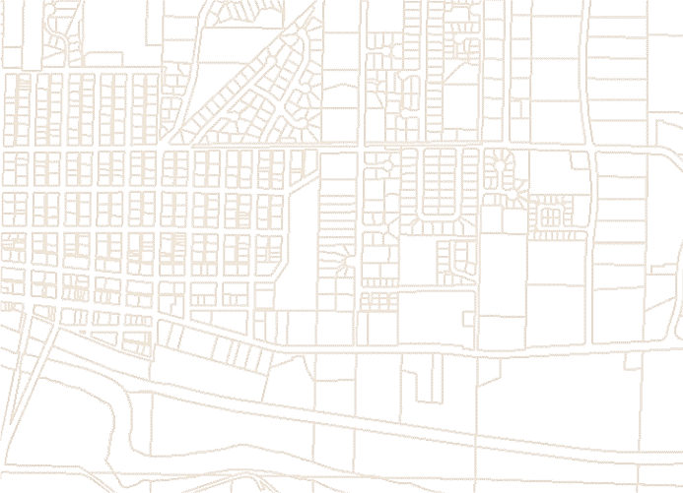


City of Duvall
2015 Comprehensive Plan
Community Open House – September 22, 2014

Slide 2
Duvall’s first Comprehensive Plan was adopted in 1992 and then updated in 2004

Slide 3
Why Do We Plan?
GMA passed in the early 90’s
Every 10 years we update CP

Slide 4
Mandates and Relationships
Growth Management Act (RCW, WAC)
VISION 2040
Multicounty Planning Policies
Countywide Planning Policies
(King, Kitsap, Pierce, Snohomish)
City & County Comprehensive Plans

Slide 5
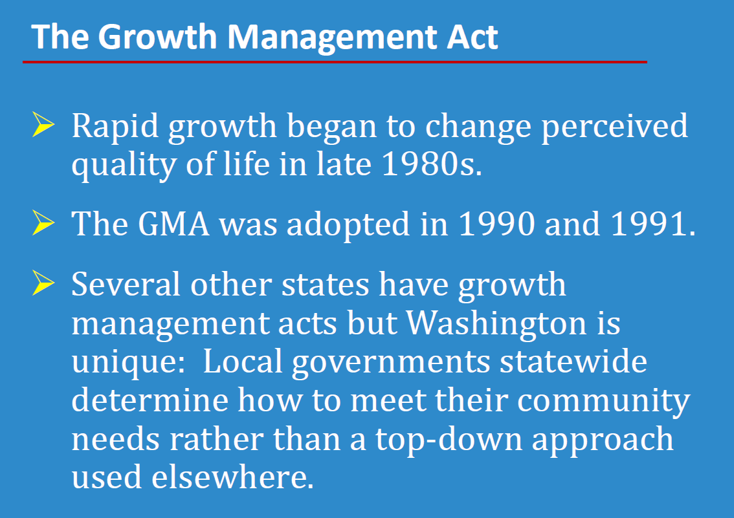

Slide 6
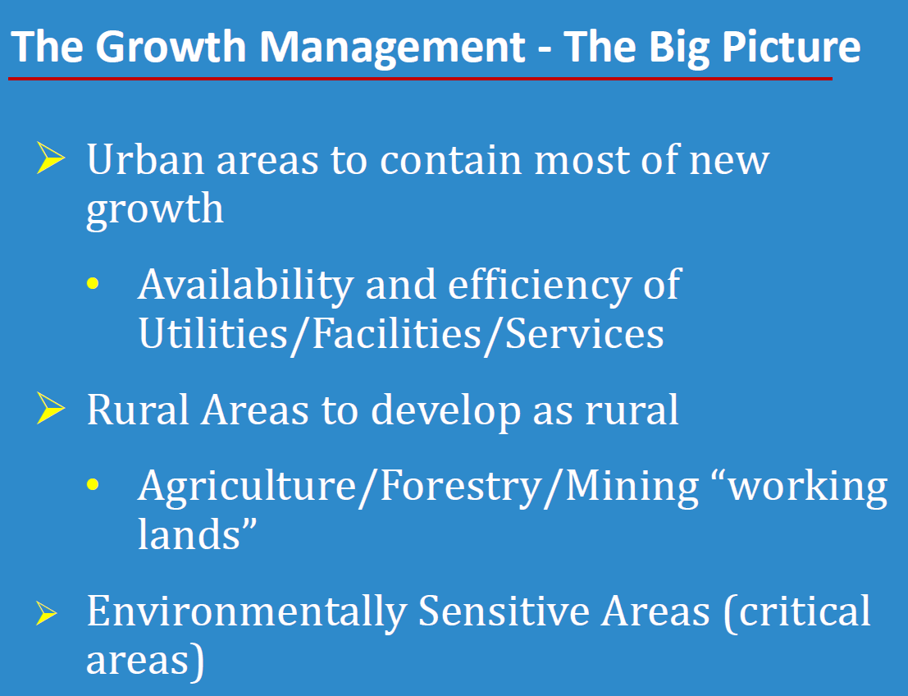

Slide 7
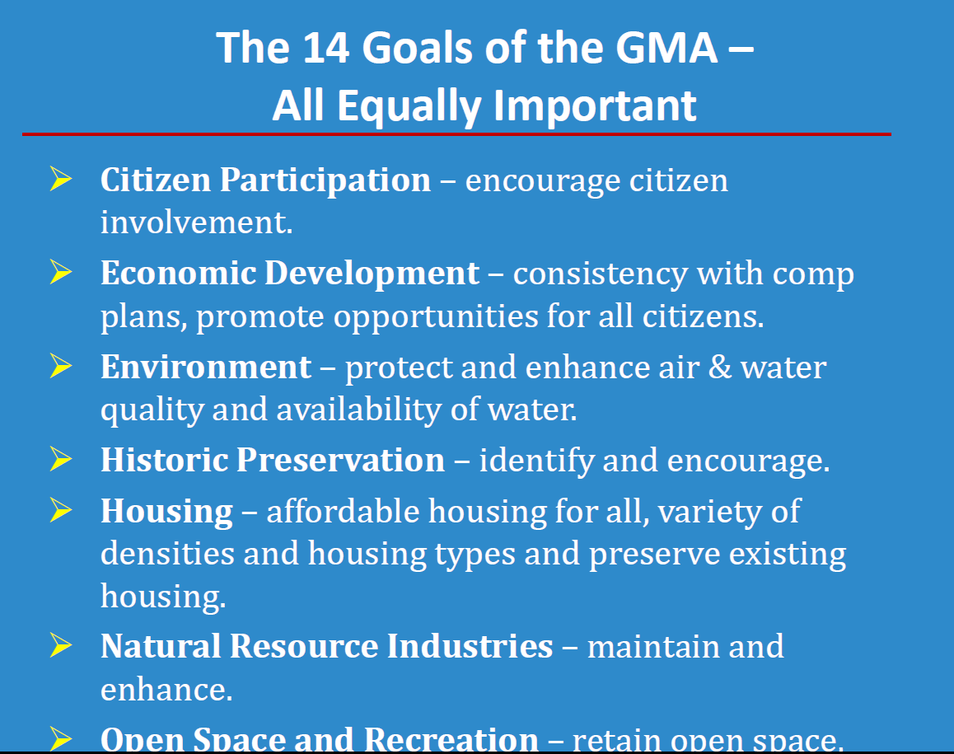

Slide 8
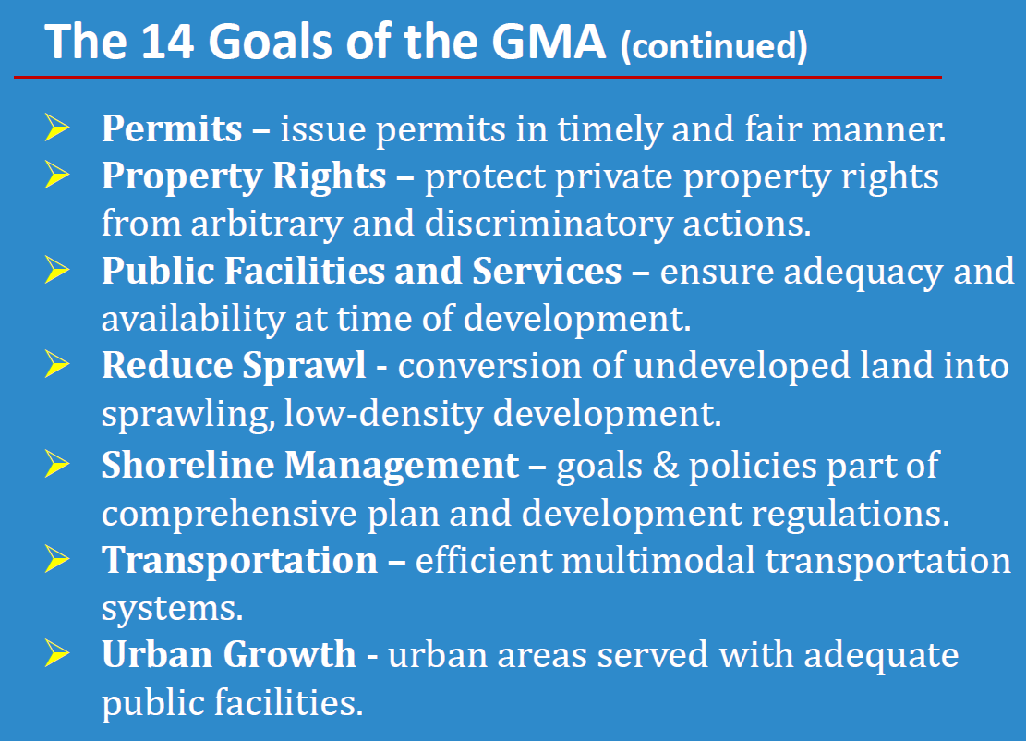

Slide 9
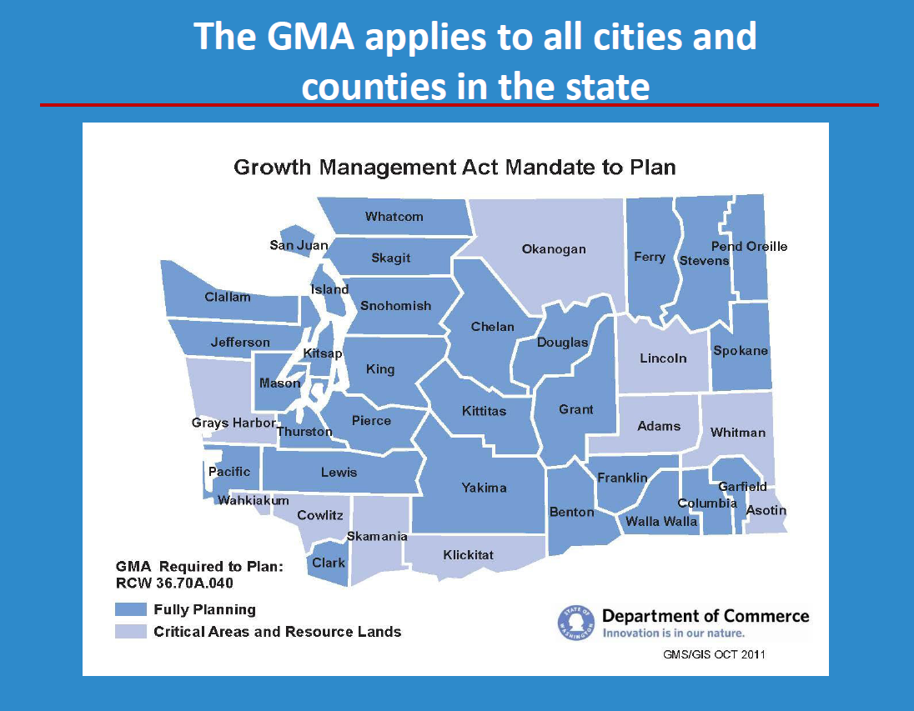

Slide 10
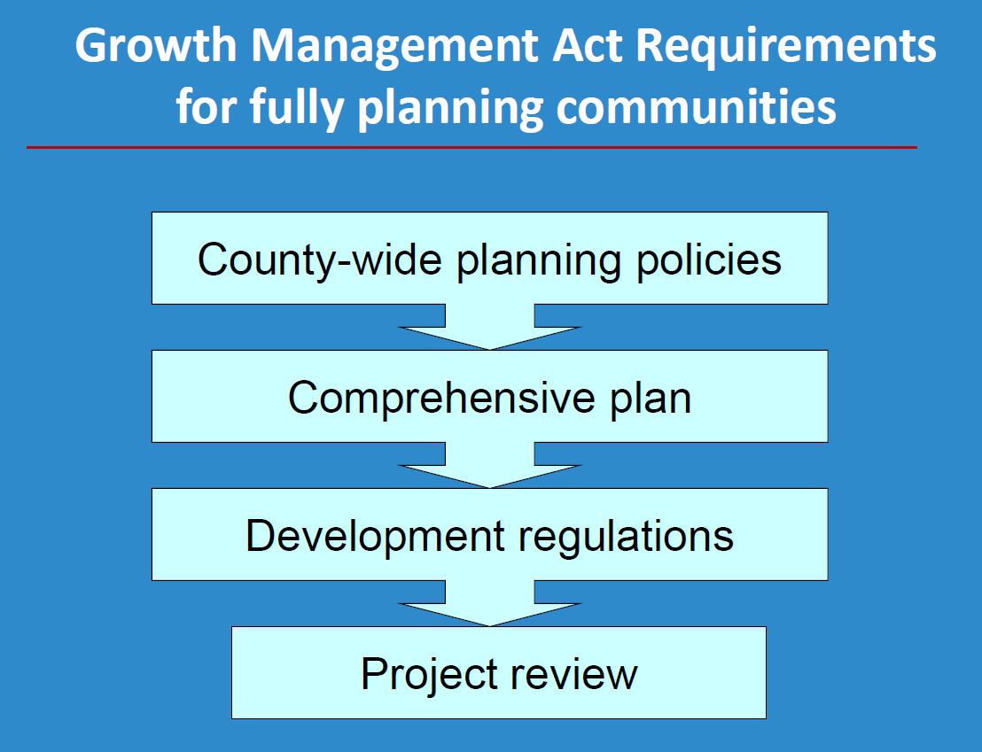

Slide 11
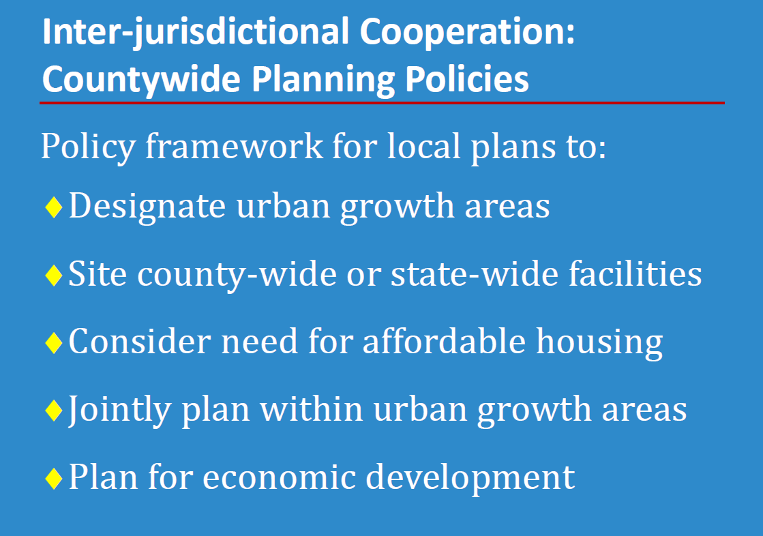

Slide 12
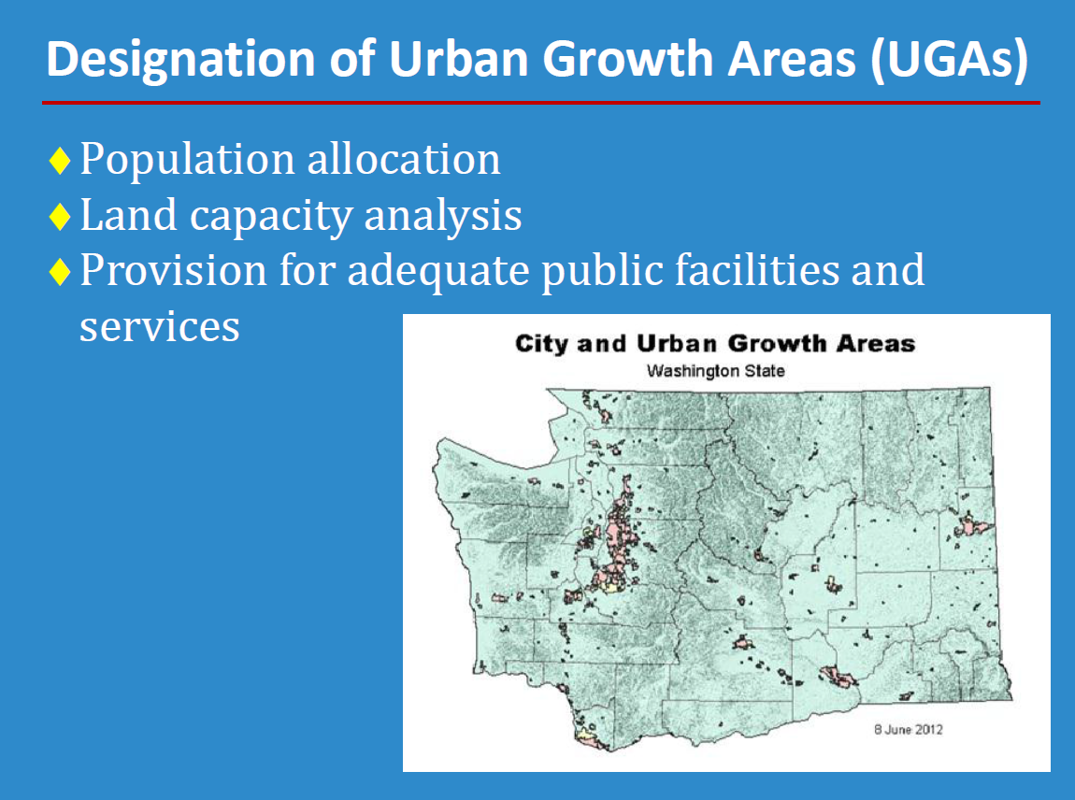

Slide 13
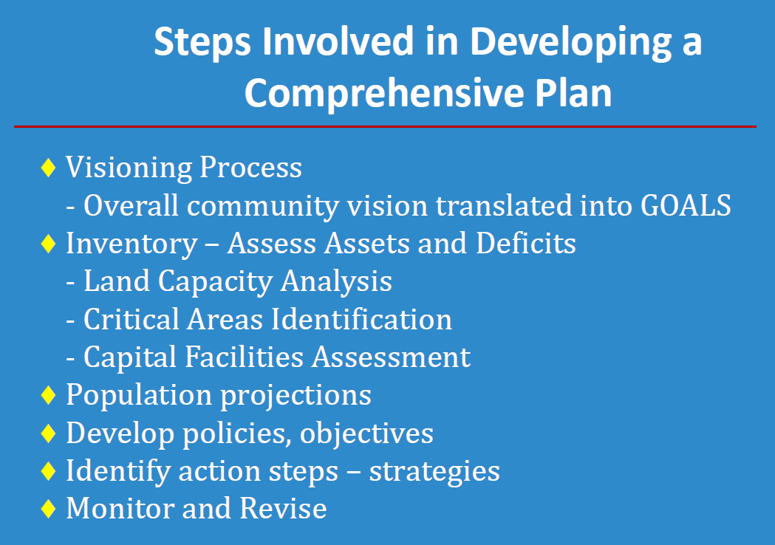

Slide 14
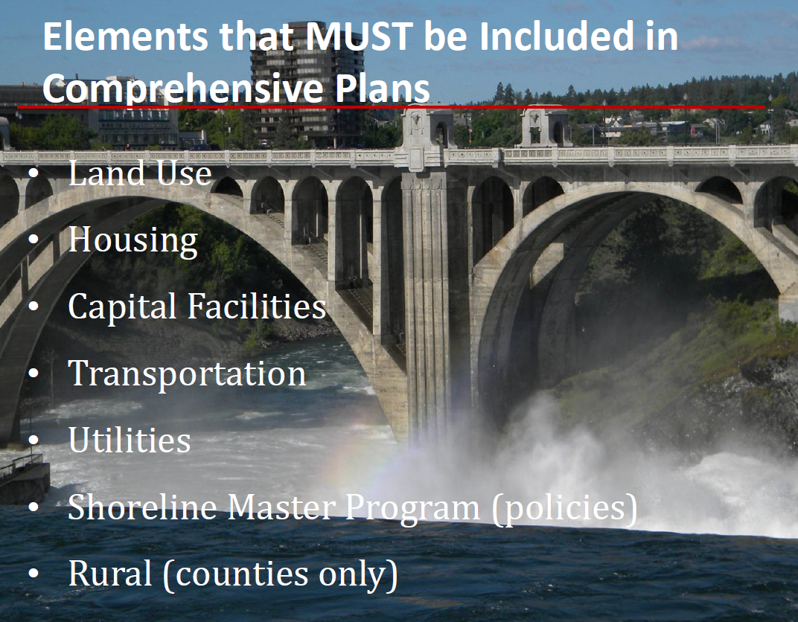

Slide 15
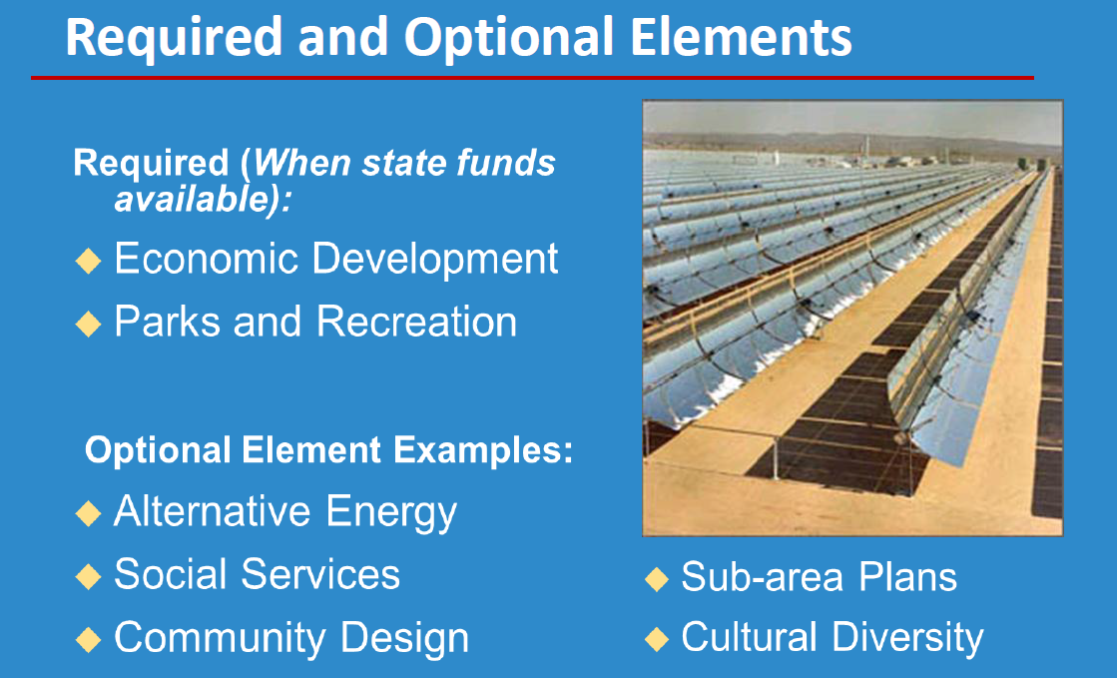
Sustainability

Slide 16
For the 2004 update:
Community survey
City Wide Vision Plan
Downtown Plan

Slide 17
Since 2004:
Updated Sensitive Area Policies
Annexation Plan
Economic Development Plan
PTOS/Park Element
Transportation Element
SMP (final phases)

Slide 18
When did we start the update?
Last Fall
Advisory Committee
Technical Advisory Committee
Planning Commission/City Council

Slide 19
First Steps
History of Duvall
GMA 101
What does our existing CP say
Does our CP remain relevant
Minor update
Community Survey
Review existing policies (temperature check)
Duvall’s Vision Statement (review/tweak)

Slide 20
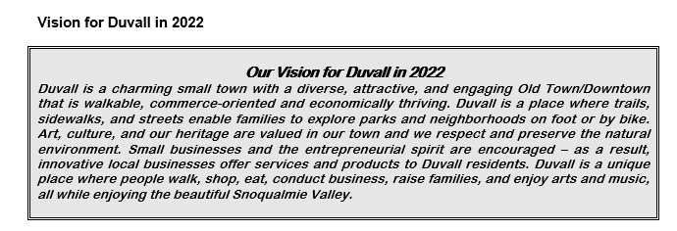

Slide 21
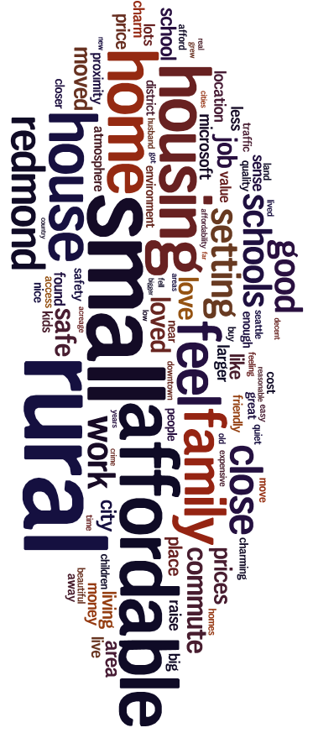
Why did you move to Duvall?

Slide 22

What are the top three things about Duvall that you value?

Slide 23

What are the top three issues facing Duvall today?

Slide 24

What are the two most important issues in the next five years?

Slide 25
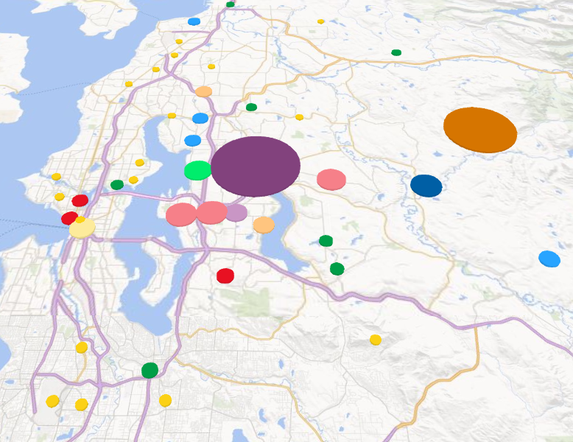
Commute Location

Slide 26
Quality of Life

Slide 27
Demographics

Slide 28

Slide Title 4
Next Steps:
Draft new elements
AC/PC/CC Review
Continued Public Review
More Community Meetings

Slide 29
We want to hear from you:
We have provided sheets of paper for you to ask questions or provide us with comments
We will respond to each comment/question
Its never to late to ask us questions
No question is dumb (if you have others do too!)
Lara Thomas 425.788.2779 ext. 2
Lara.Thomas@duvallwa.gov

