Slide 1
2015 Comprehensive Plan Update
September 23, 2013
Advisory Committee Meeting
Kick Off

Slide 2
Agenda
Introductions – Go around the room (10 minutes) Mayor
Comprehensive Planning and Growth Management 101 (10 minutes) Lara Thomas
Round Robin Questions (60 minutes) Mayor
Questions (10-15 minutes)

Slide 3

Comprehensive Planning and Growth Management 101

Slide 4
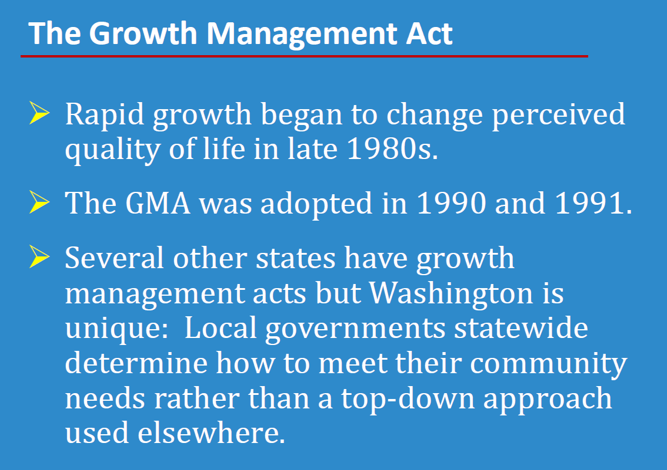

Slide 5
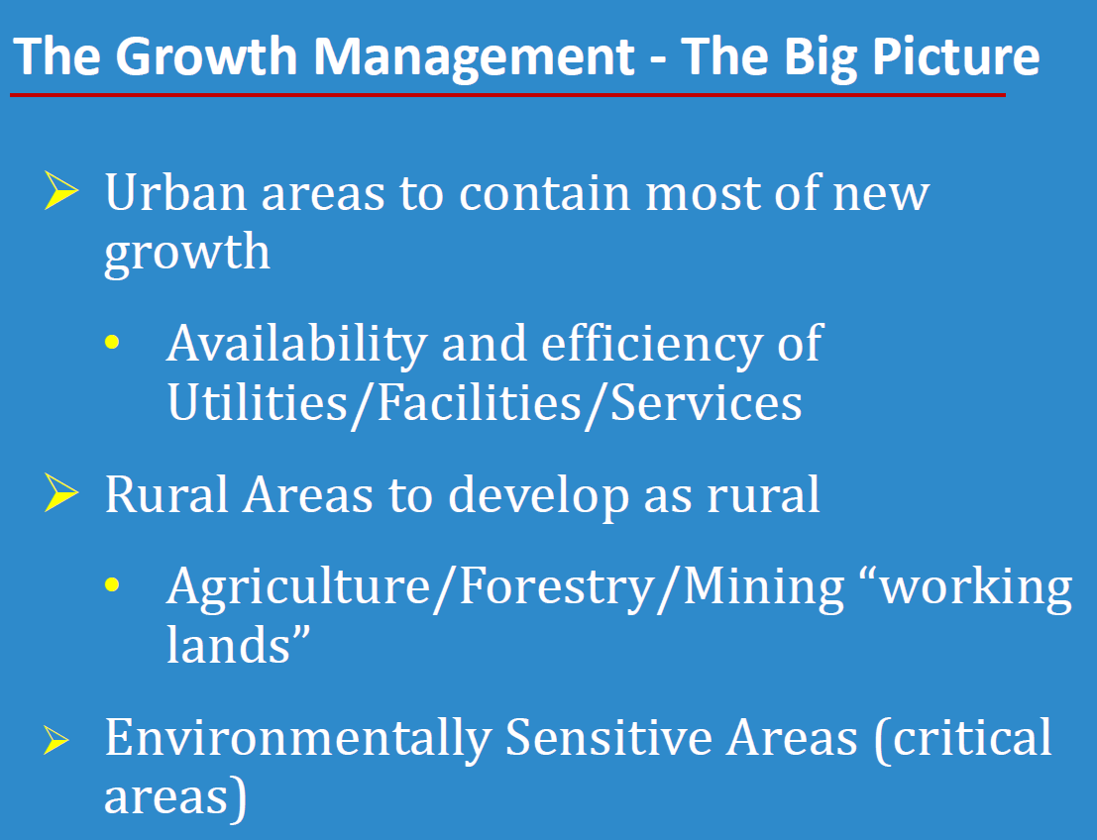

Slide 6
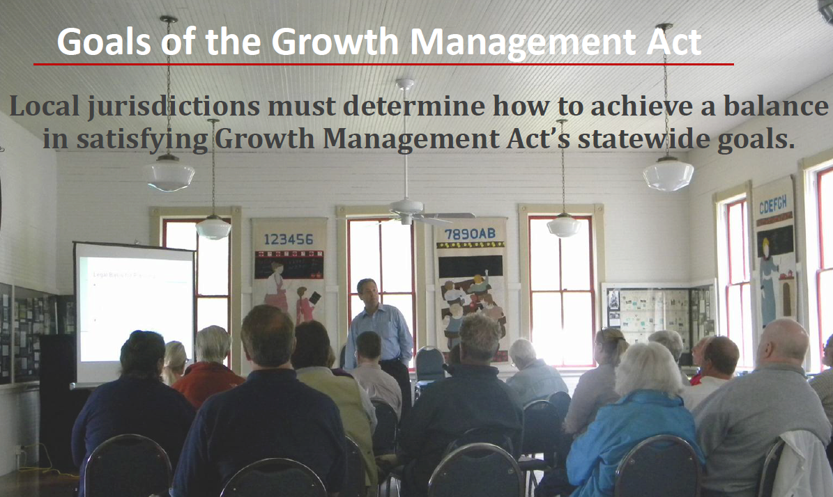

Slide 7
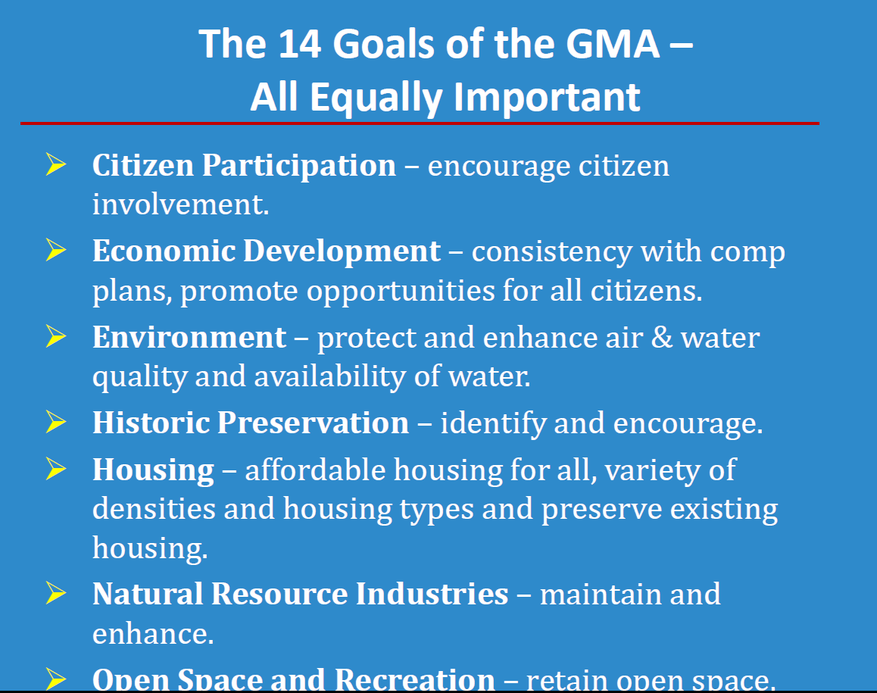

Slide 8
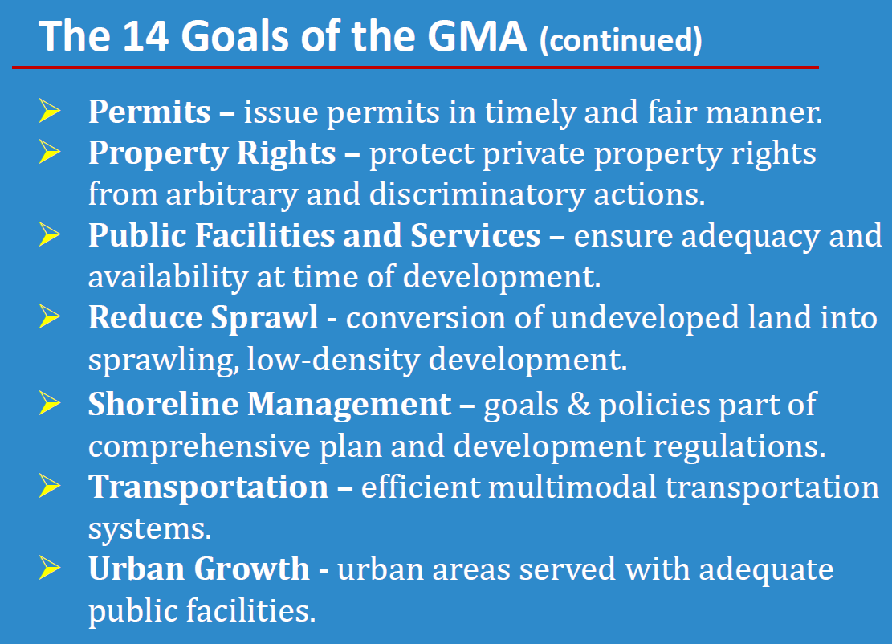

Slide 9
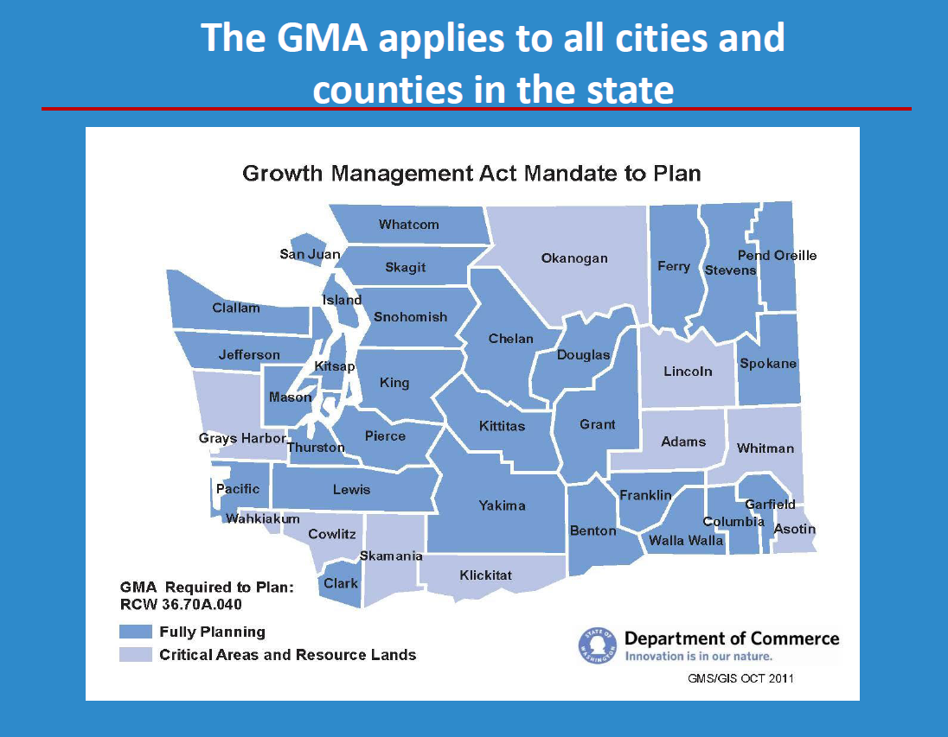

Slide 10
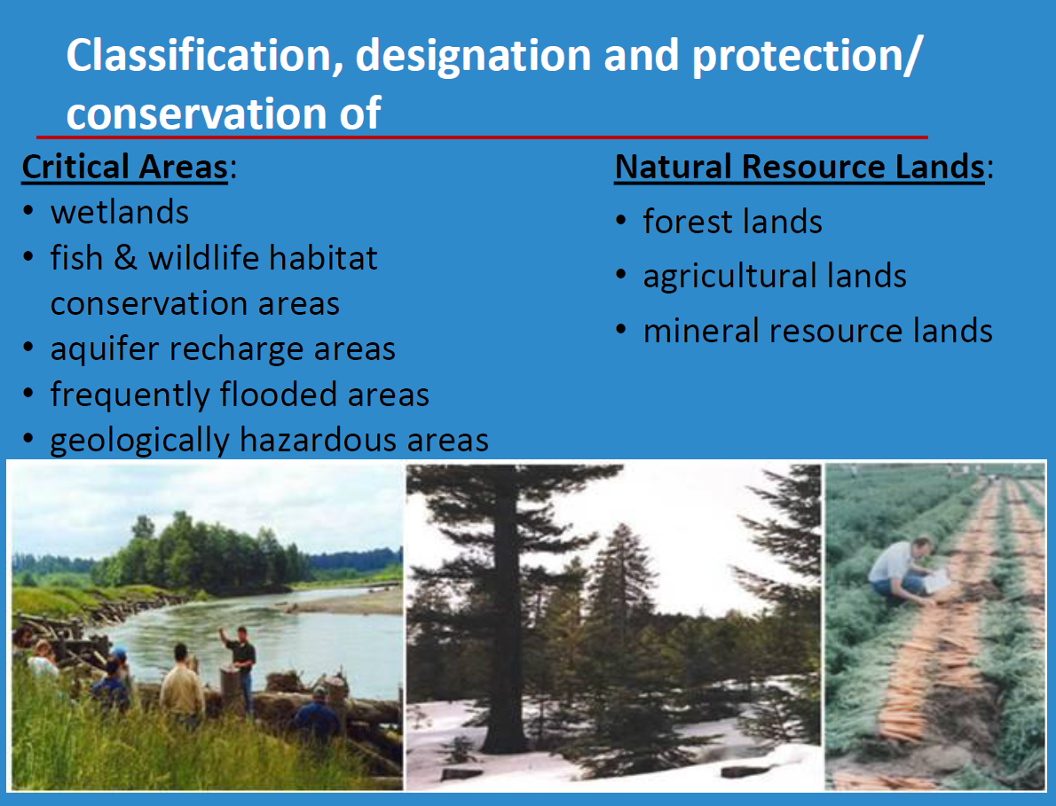

Slide 11
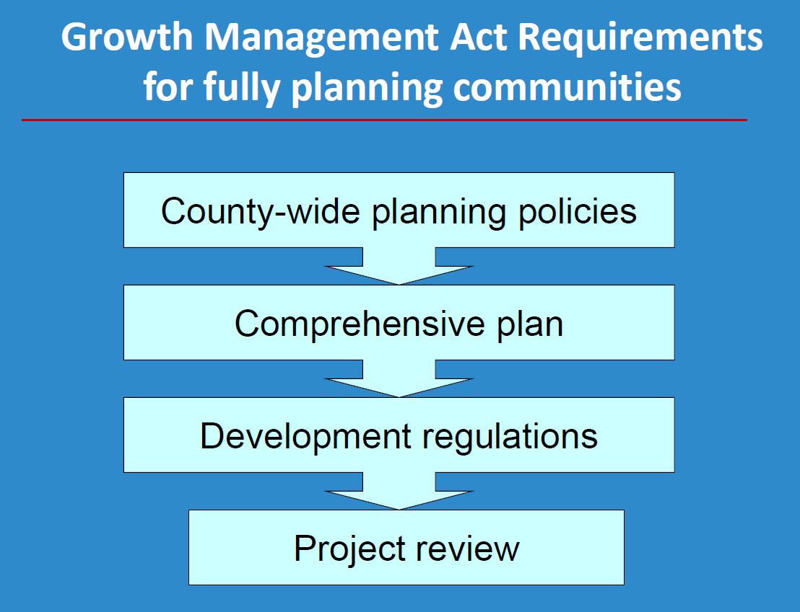

Slide 12
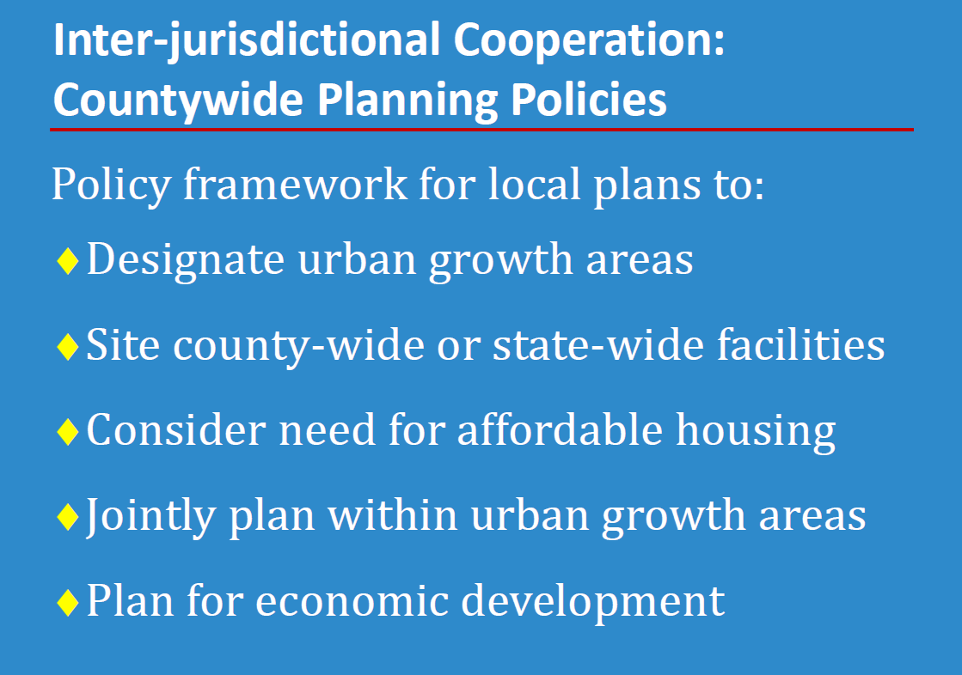

Slide 13
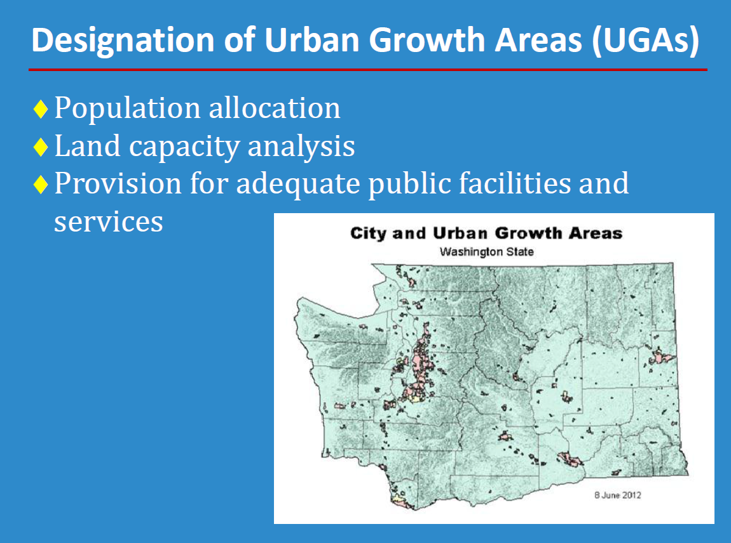

Slide 14
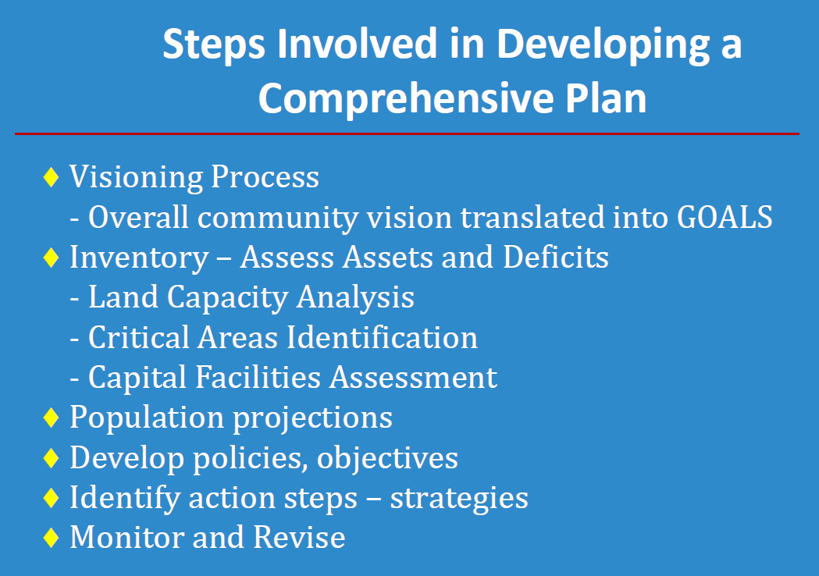

Slide 15
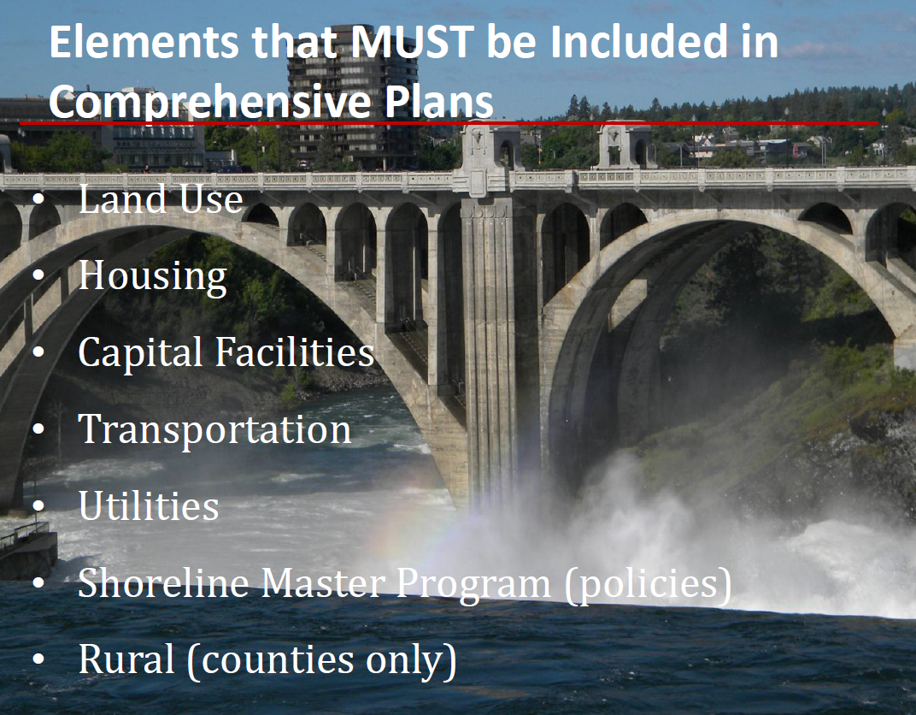

Slide 16
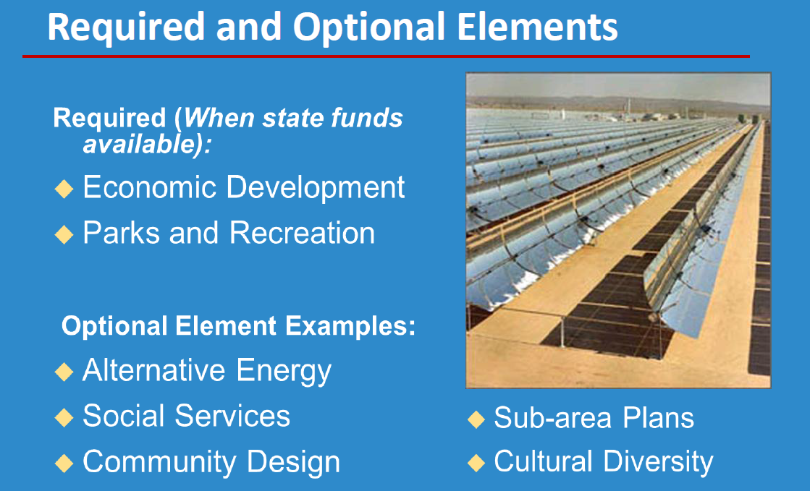

Slide 17
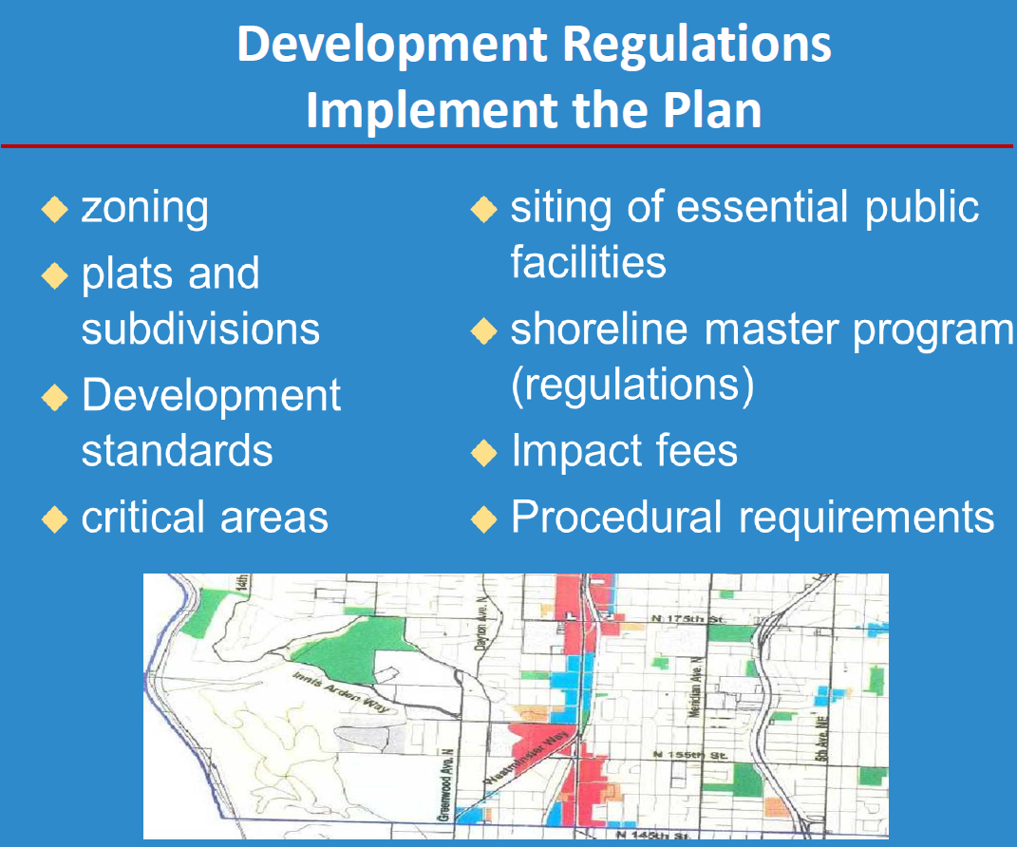

Slide 18
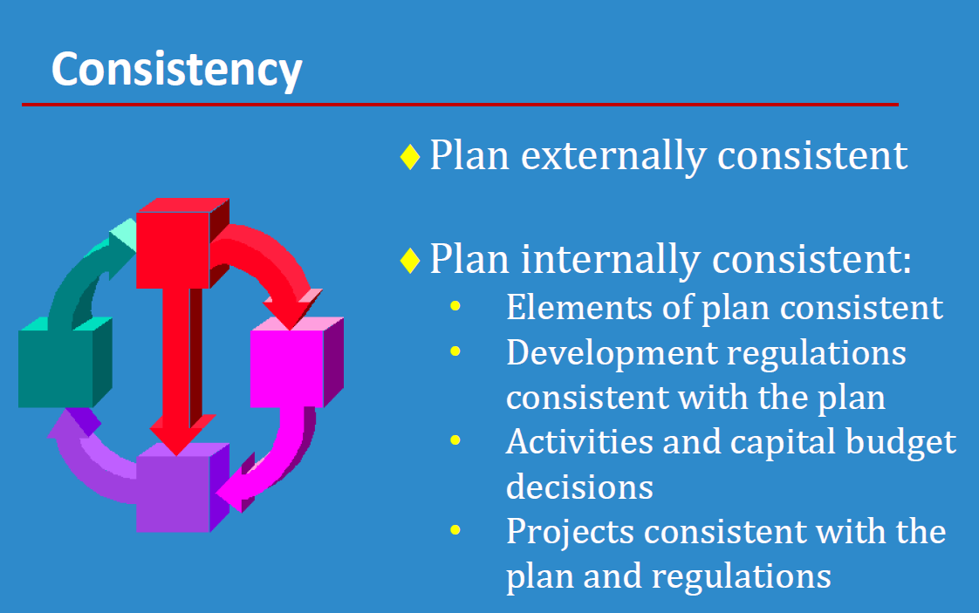

Slide 19
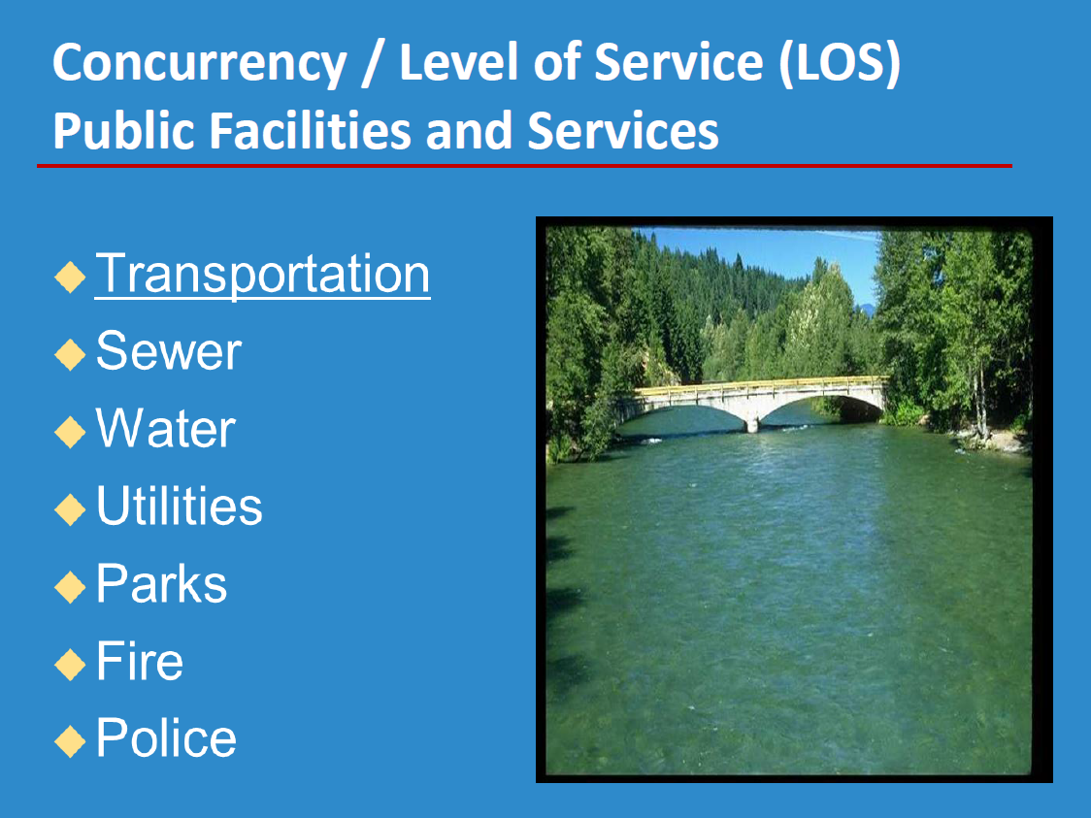

Slide 21
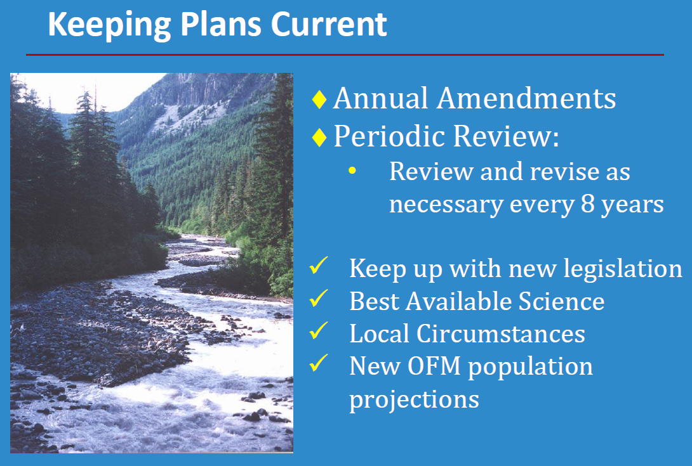

Slide 22
Round Robin Questions

