Slide 1
PSRC and Comprehensive Plan Updates
City of Duvall Joint Planning Commission / City Council
Duvall, WA
March 5, 2014

Slide 2
VISION 2040 & Comprehensive Plan Updates
PSRC Overview
VISION 2040
Plan Review and Certification
T2040 update/other PSRC news

Slide 3
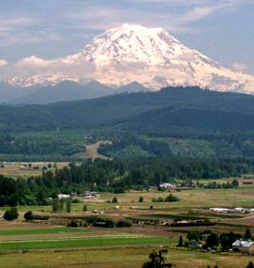

What We Do
Puget Sound Regional Council (PSRC):
Metropolitan Planning Organization,
Regional Transportation Planning Organization,
Council of Governments
Regional Growth, Economic and Transportation Planning
Federal transportation funds to priority projects
Regional data and forecasts
Forum for regional issues
Notes:
3

Slide 4


Who We Represent
Our Region
4 Counties
82 Cities and Towns
Urban & Rural
Our Members
Cities, Counties, Ports and Transit
State Agencies and Tribal Governments
Notes:
4

Slide 5

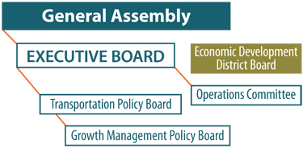
PSRC Governance Structure
General Assembly
Votes on major regional decisions, approves budget, elects new officers
Executive Board
Carries out delegated powers and responsibilities
Transportation Policy Board
Makes recommendations on key transportation issues
Growth Management Policy Board
Makes recommendations on key growth management issues
Economic Development District Board
Regional economic development planning and collaboration with private and public sector agencies
Federated Structure - Representatives Appointed by Members
Membership Organization
Formed by Interlocal Agreement
MPO Designation by Governor
Notes:
5

Slide 6

VISION 2040

Slide 7
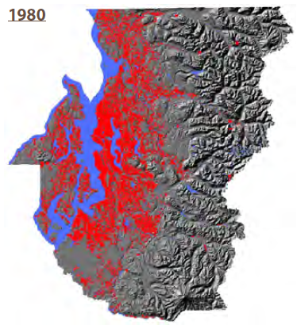
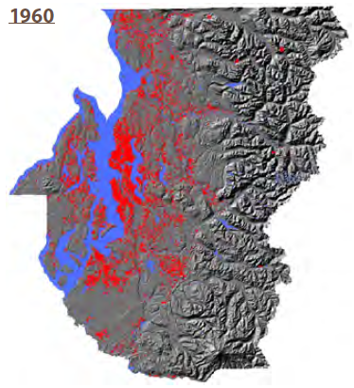
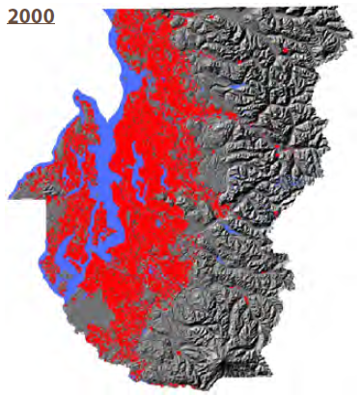
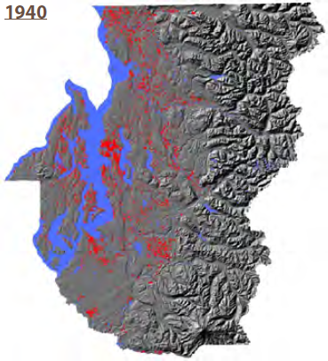
Region Continues to Grow
~100 new residents per day
[births]-[deaths]+[net migration]
Changing demographics
By 2040, our 65+ population will reach 17%
More diverse
Changing Roles & Objectives

Slide 8
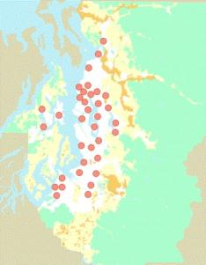
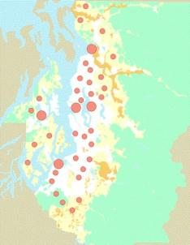
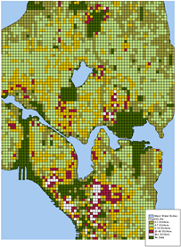

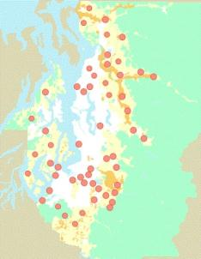
Developing VISION 2040
Scoping and research
Alternatives analysis
Policy development
Outreach and public participation
Regional agreement

Slide 9

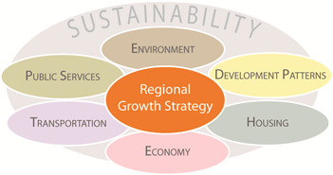
VISION 2040: People, Prosperity, and Planet
Concepts
People, Prosperity, Planet
Sustainability woven throughout
Integration of growth management, transportation, economy & environment
Revised & New Elements
Environmental framework
Numeric regional growth strategy
Revised & expanded multicounty planning policies
Actions, measures & monitoring

Slide 10
Mandates and Relationships
Growth Management Act (RCW, WAC)
VISION 2040
Multicounty Planning Policies
Countywide Planning Policies
(King, Kitsap, Pierce, Snohomish)
City & County Comprehensive Plans
(4 counties, 82 cities)

Slide 11
Multicounty Planning Policies
Regional Guidelines & Principles
Summarized in Plan Review Manual
Environment, Housing new

Slide 12
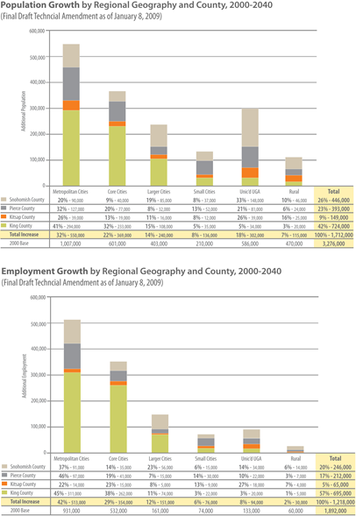
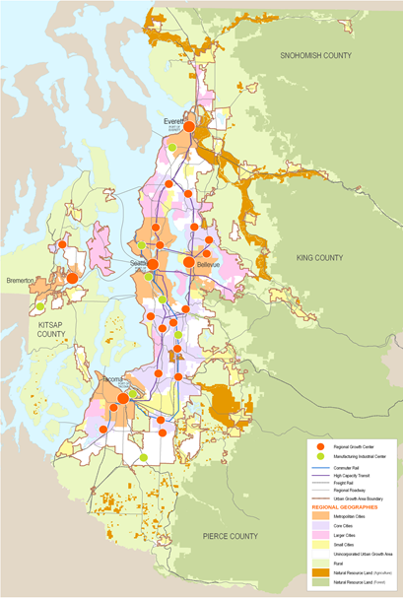
Regional Growth Strategy
Numeric Guidance for Local Planning & Targets
Builds on GMA foundation
Different types of cities, different roles
Compact development
Concentrate jobs, housing, and activities in cities and centers
Focus urban growth in Metropolitan, Core, and Larger Cities
Reduce Rural growth
Improve regional jobs-housing balance

Slide 13
Regional Growth Strategy – Implementation
Growth targets under VISION 2040
Almost finished
Local jurisdictions translate into comp plan assumptions
RGS also addressed via
Transportation 2040 update
Project prioritization and regional growth strategy cross-check
Forecast products – Local Targets Representation dataset

Slide 14
PSRC Land Use Forecast Datasets
 | Land Use Baseline | Land Use Targets | Land Use Vision
Description | UrbanSim land use forecast based on development capacities established through local comprehensive plans | Future land use dataset based on local 2025-2035 growth targets* developed to align with VISION 2040
Horizon Year | 2040 | 2025/30/31/35
RGS | Forecasts growth under VISION 2020, not VISION 2040 | Consistent w/ V2040 regional growth strategy
REF | Reflects latest 2012 regional economic forecast | Reflects older 2005 regional economic forecast
*Placeholder target values utilized for Kitsap and Snohomish jurisdictions until local target updates completed in 2013.

Slide 15
Plan Review & Certification

Slide 16
Plan Review & Certification
Formal role: Certification under GMA
Communicate and coordinate on regional issues
Implement VISION 2040 and other regional plans

Slide 17
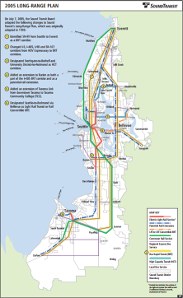
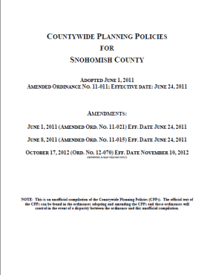
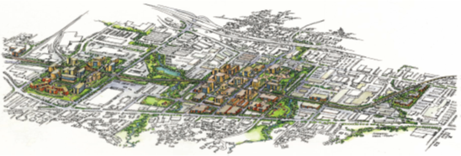
What plans does PSRC review?
Countywide planning policies
Local comprehensive plans
Regional center plans
Transit agency plans

Slide 18
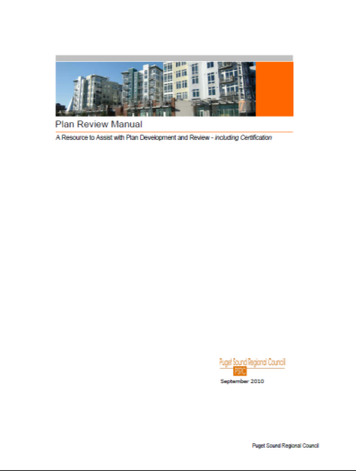
What’s Required for Certification?
Consistency with Multicounty Planning Policies
(= Regional Guidelines & Principles)
Consistency with Transportation 2040
Conformity with transportation planning requirements in Growth Management Act
Note: Requirements spelled out in RCW 47.80
Resource
PSRC Plan Review Manual

Slide 19

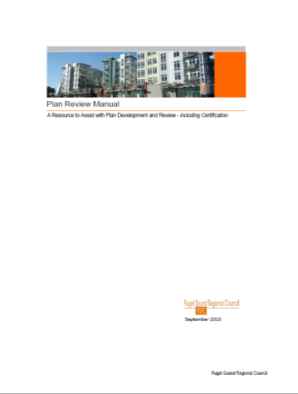

What we do
Technical assistance

Slide 20
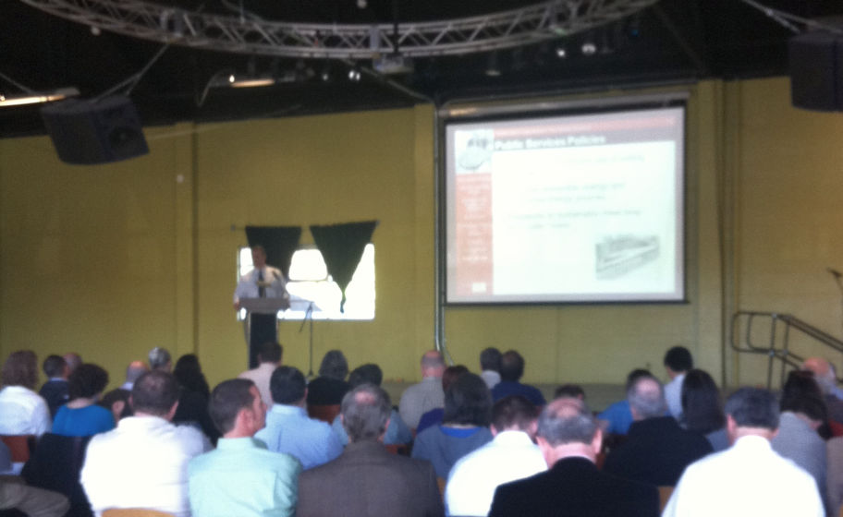
What we do
Technical assistance
Outreach (proactive)

Slide 21
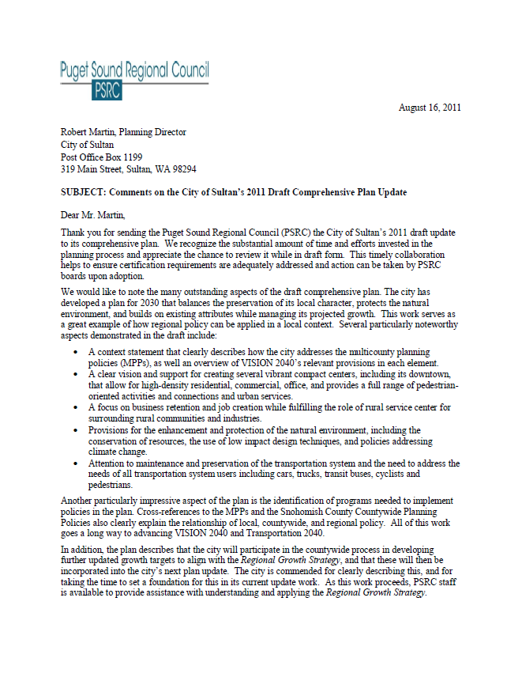
What we do
Technical assistance
Outreach (proactive)
Comment letters

Slide 22
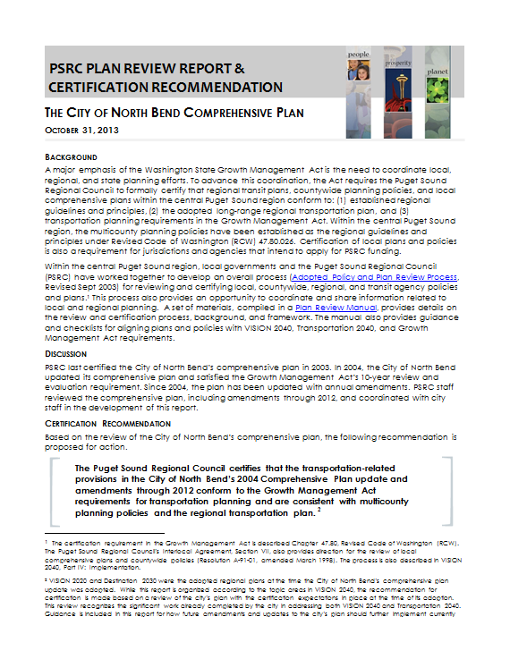
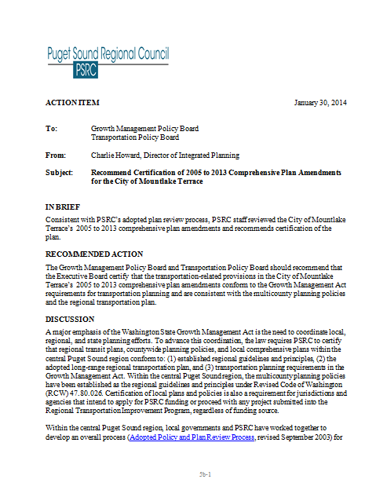
What we do
Technical assistance
Outreach (proactive)
Comment letters
Certifications

Slide 23
Comments by Topic

Slide 24
Frequently Asked Questions
How often does plan review occur?
… as updates or amendments take place…
Is our previously certified plan currently certified—and for how long?
…plans retain certification status until updated or amended…
What if our updated plan is not certifiable?
…Only jurisdictions with certified plans are eligible to apply for PSRC-managed funds and some other grants, including projects sponsored by another agency within the jurisdiction

Slide 25
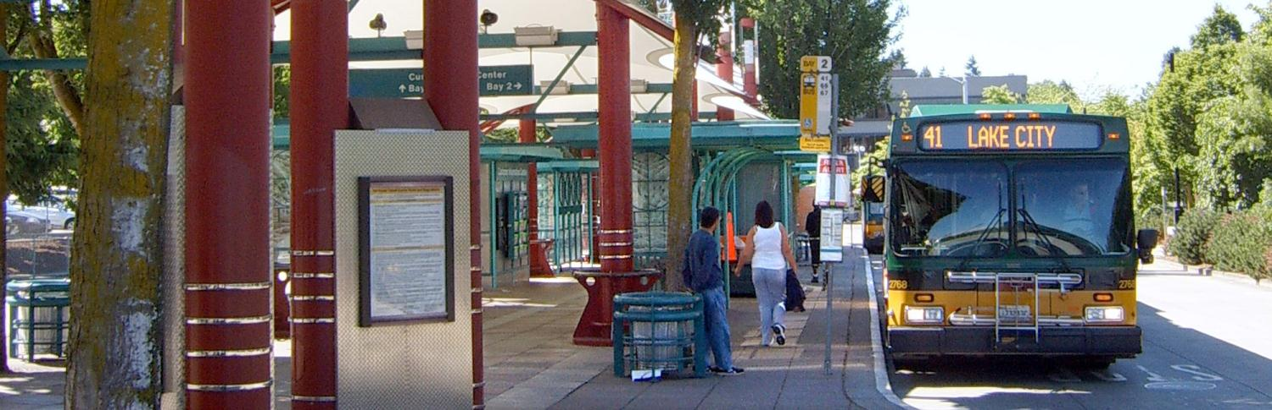
Transportation 2040 Update

Slide 26
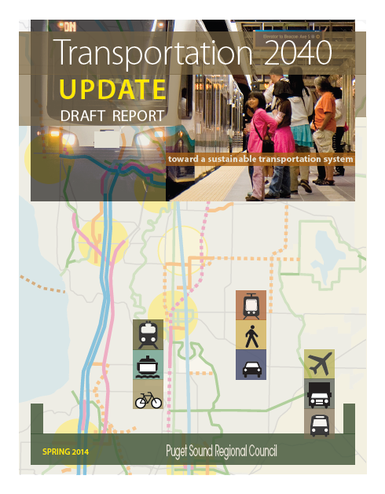
Transportation 2040 Update - Scope of Work
26
Core Elements
State of Good Repair Update
Prioritization
Financial strategy Update
Statutory and Ongoing Activities
(Active Transportation Plan, Air Quality Conformity/GHG Update,
TDM/CTR Programs, Growing Transit Communities, Rural Transportation Study)
Supporting Information
(Project list, Public involvement & outreach, Environmental Justice, Analysis tools, MAP-21)

Slide 27
T2040 Update Schedule

Slide 28
Plan Update - Next Steps
28
March 10 Comment period concludes
March 13 TPB reviews results
April 3 Release SEPA Addendum
April 10 TPB recommendation to Executive Board
April 24 EB recommendation to General Assembly
May 29 General Assembly adopts Plan Update

Slide 29
Other
Regional Industrial Lands Study
Centers Monitoring Report

